Slide 1

DATA ANALYTICS INTERNSHIP 2024 Final Project Presentation
Project: Analyzing renewable energy production across different nations and their effects on carbon emissions
Team : LazyBuds
College : Maharaja Agrasen Institute of Technology
IBM SKillsBuild Data Analytics

Slide 2
TEAM MEMBERS
RACHIT MITTAL
ARJUN YADAV
SHIVAM BAJPAI
GAURAV DHARIWAN
VIPIN SINGH
HARSH VARDHAN

Slide 3
INTRODUCTION
This project explores the impact of renewable energy generation on carbon emissions reduction and examines the variation in renewable energy production across different countries.
By analyzing data on renewable energy sources like solar, wind, and hydro, and their respective contributions to decreasing greenhouse gas emissions, this study aims to highlight the global disparities and progress in transitioning to sustainable energy systems.
The findings will provide insights into how different nations are addressing climate change through renewable energy and the challenges they face in achieving their energy goals.

Slide 4

PROBLEM STATEMENT
analyze how renewable energy generation has contributed to carbon emissions reduction and to investigate the disparities in renewable energy production worldwide.
RATIONALE
The rationale for this project lies in the urgent need to address climate change by reducing carbon emissions through the adoption of renewable energy sources. Renewable energy, such as solar, wind, and hydro, offers a sustainable alternative to fossil fuels, yet its adoption varies significantly across different countries

Slide 5
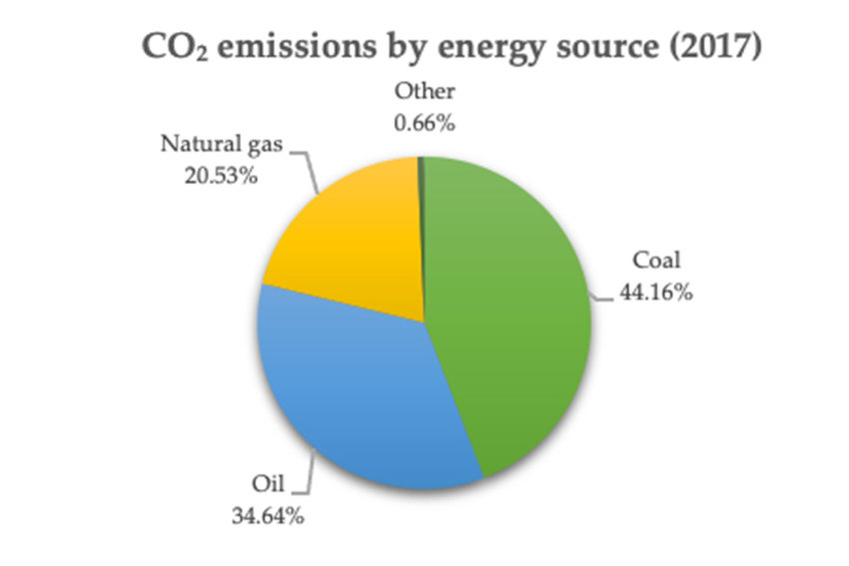
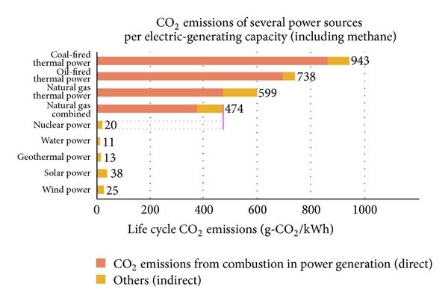
SIGNIFICANCE
By analyzing the impact of renewable energy generation on carbon emissions reduction and examining the disparities in production, this project seeks to identify best practices and challenges. Understanding these variations is essential for informing policy decisions, fostering international cooperation, and accelerating the global transition to renewable energy, ultimately contributing to a more sustainable and resilient future.
As a result, thoroughly analyzing the data of different regions helps us to predict with accuracy the carbon footprint of each nation, and consequently their individual responsibility.

Slide 6






Relevant Sustainable Development Goals (SDGs)
SDG 7: Affordable and Clean Energy
SDG 13: Climate Action
SDG 9: Industry, Innovation, and Infrastructure
SDG 12: Responsible Consumption and Production
SDG 17: Partnerships for the Goals

Slide 7
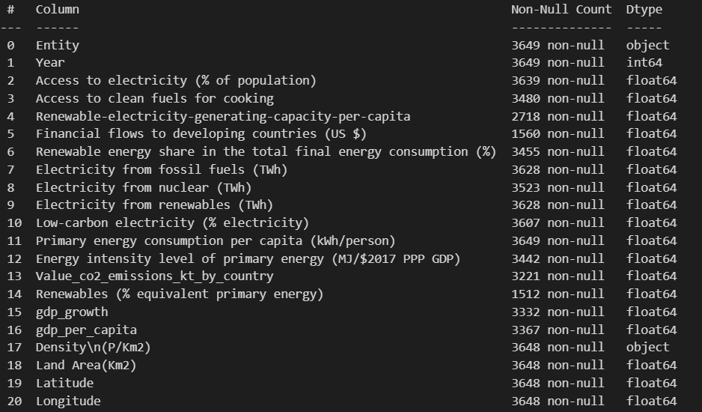
DATA COLLECTION
Data Source: Taken from Kaggle. Several features present which enable us to study in-depth about the relationship between energy production
and carbon emissions.

Slide 8
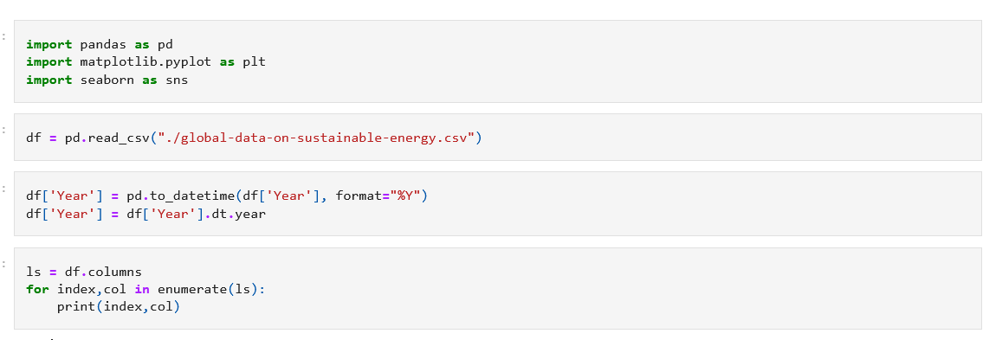

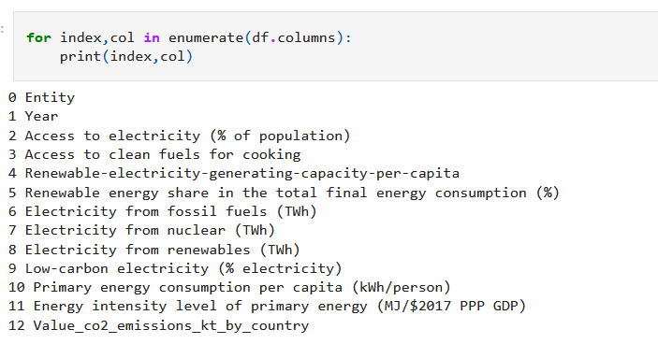
Data Preprocessing
Handling Missing Values: Techniques include removing, imputing, or interpolating missing data.
Removing Duplicates: Identifying and removing duplicate records.
Correcting Errors: Fixing inaccuracies or inconsistencies in the data.
Outlier Detection: Identifying and handling outliers that can skew analysis.

Slide 9
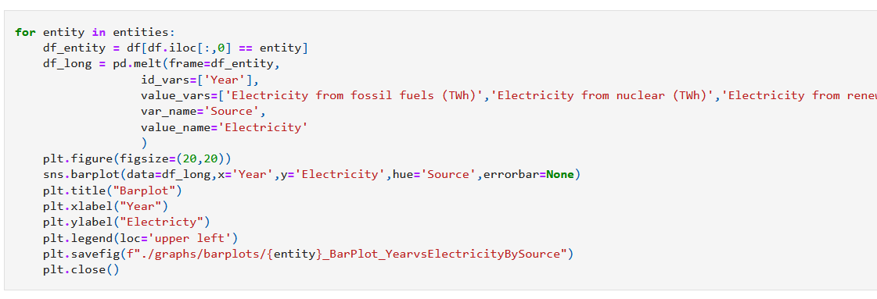
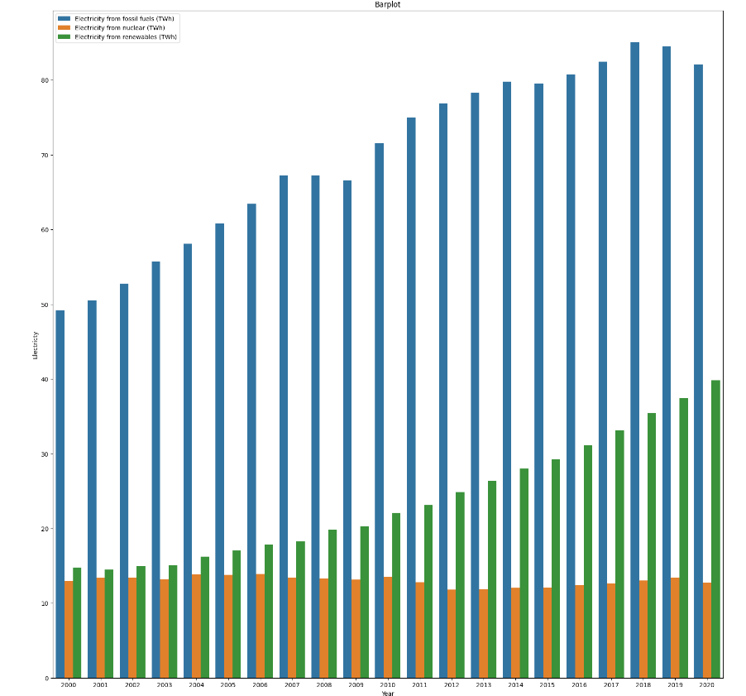
COMPARISON BETWEEN DIFFERENT ENERGY SOURCES
This plot the bar graph for electricity consumption from multiple sources vs Year.
Includes data for all regions.

Slide 10
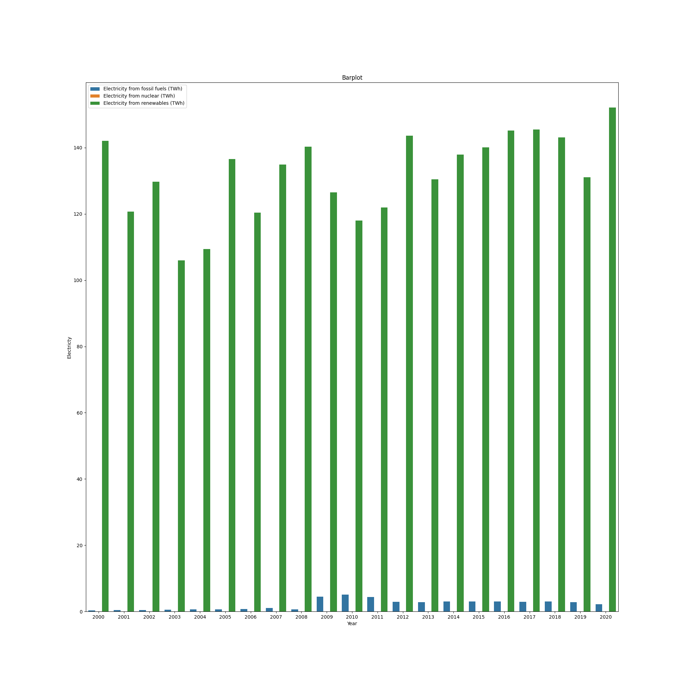
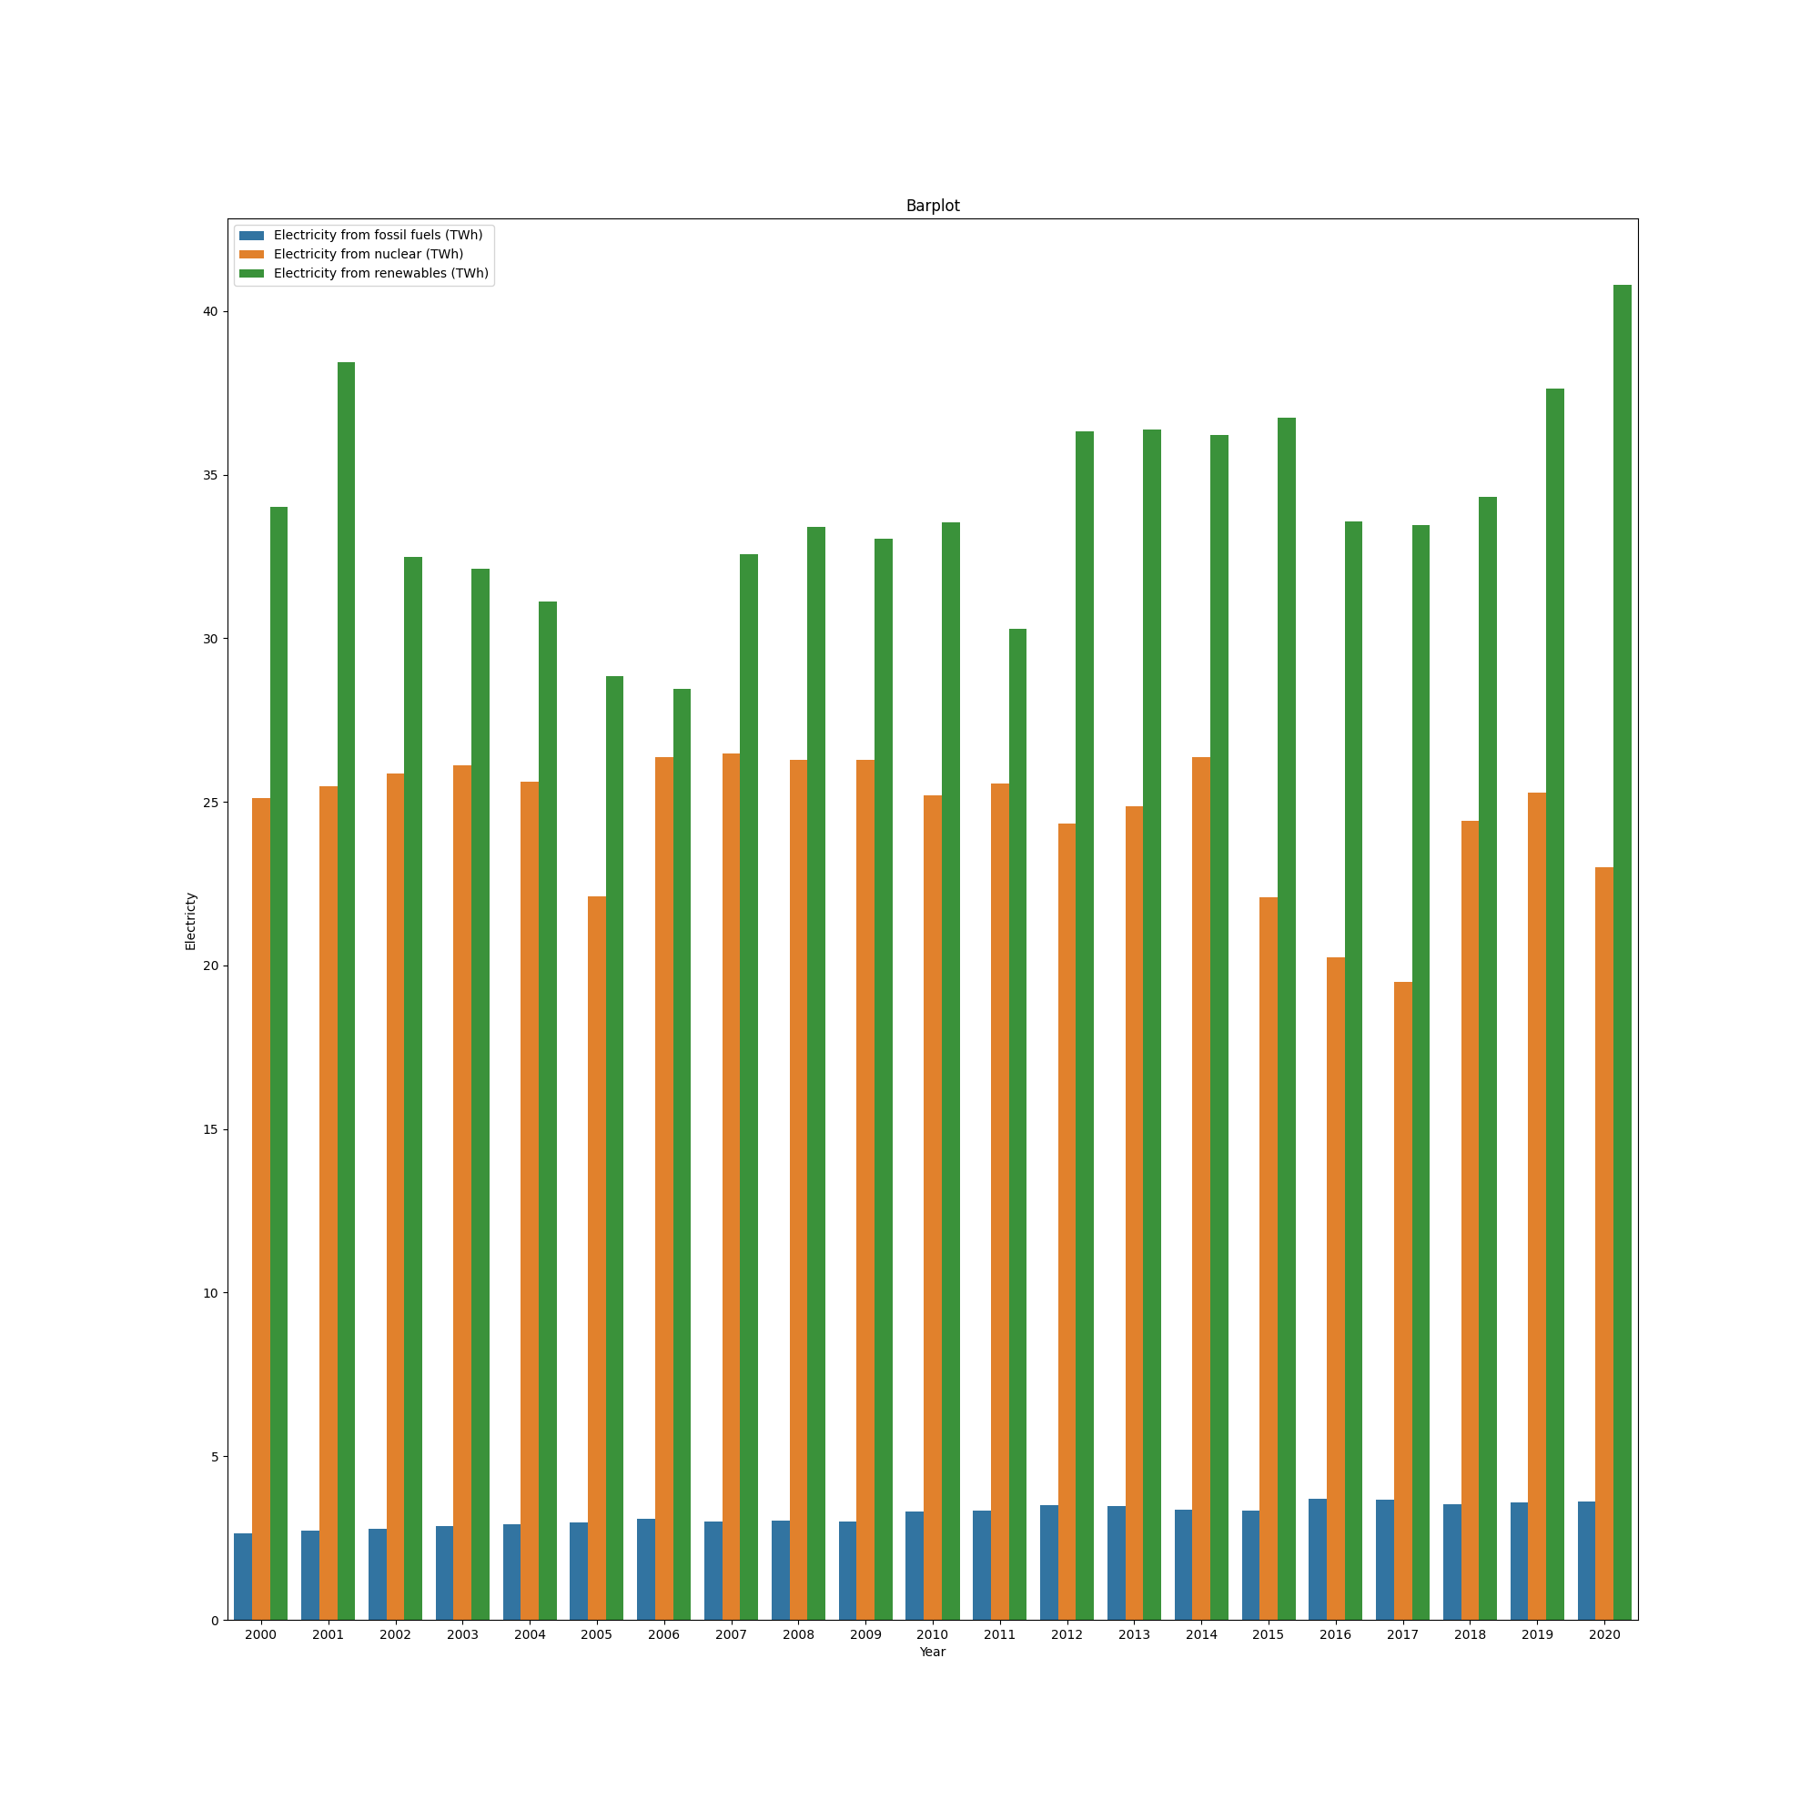
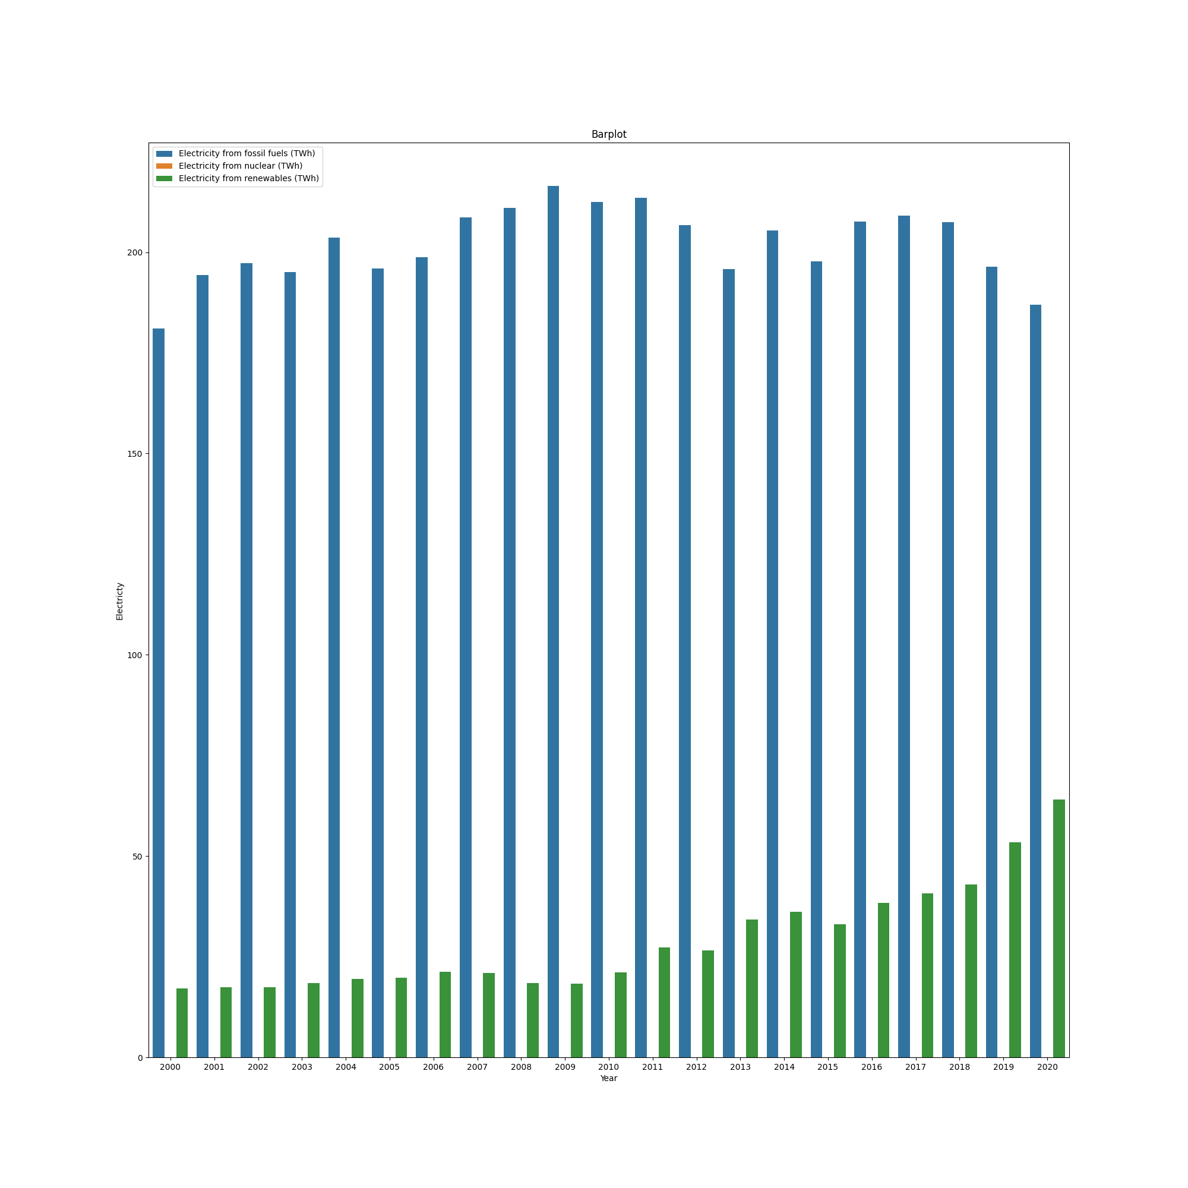
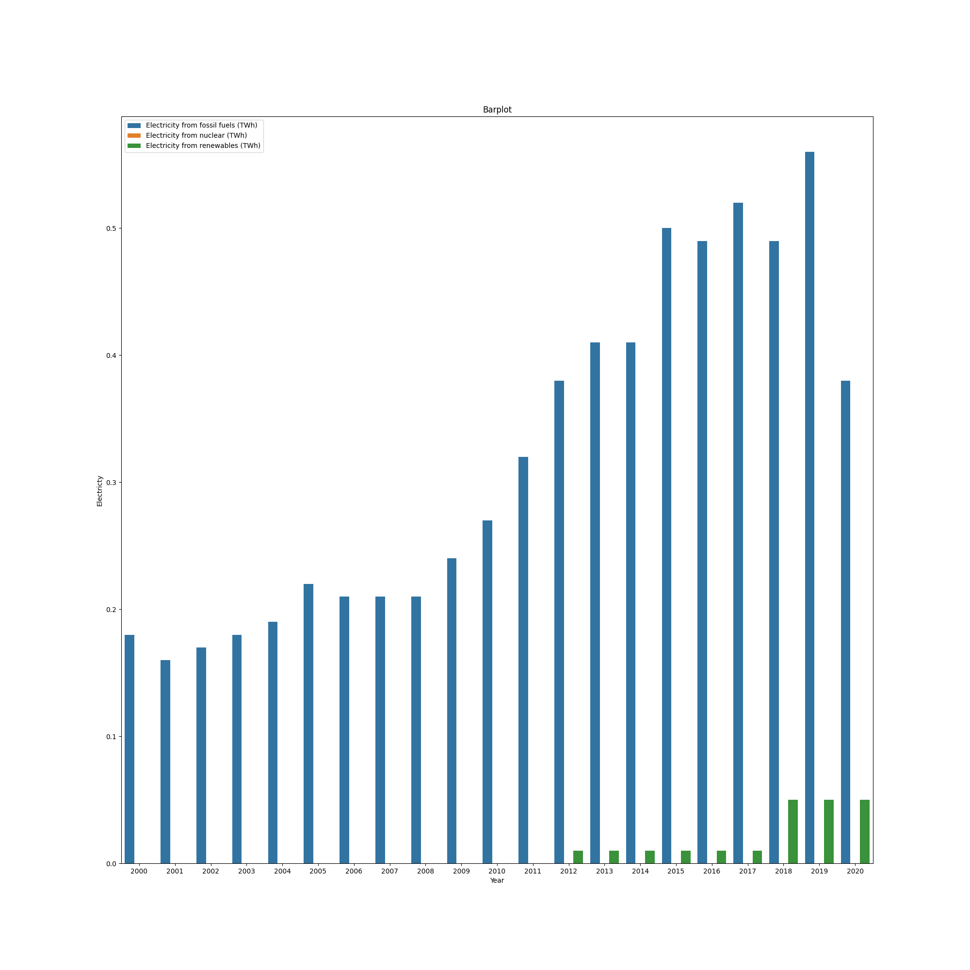
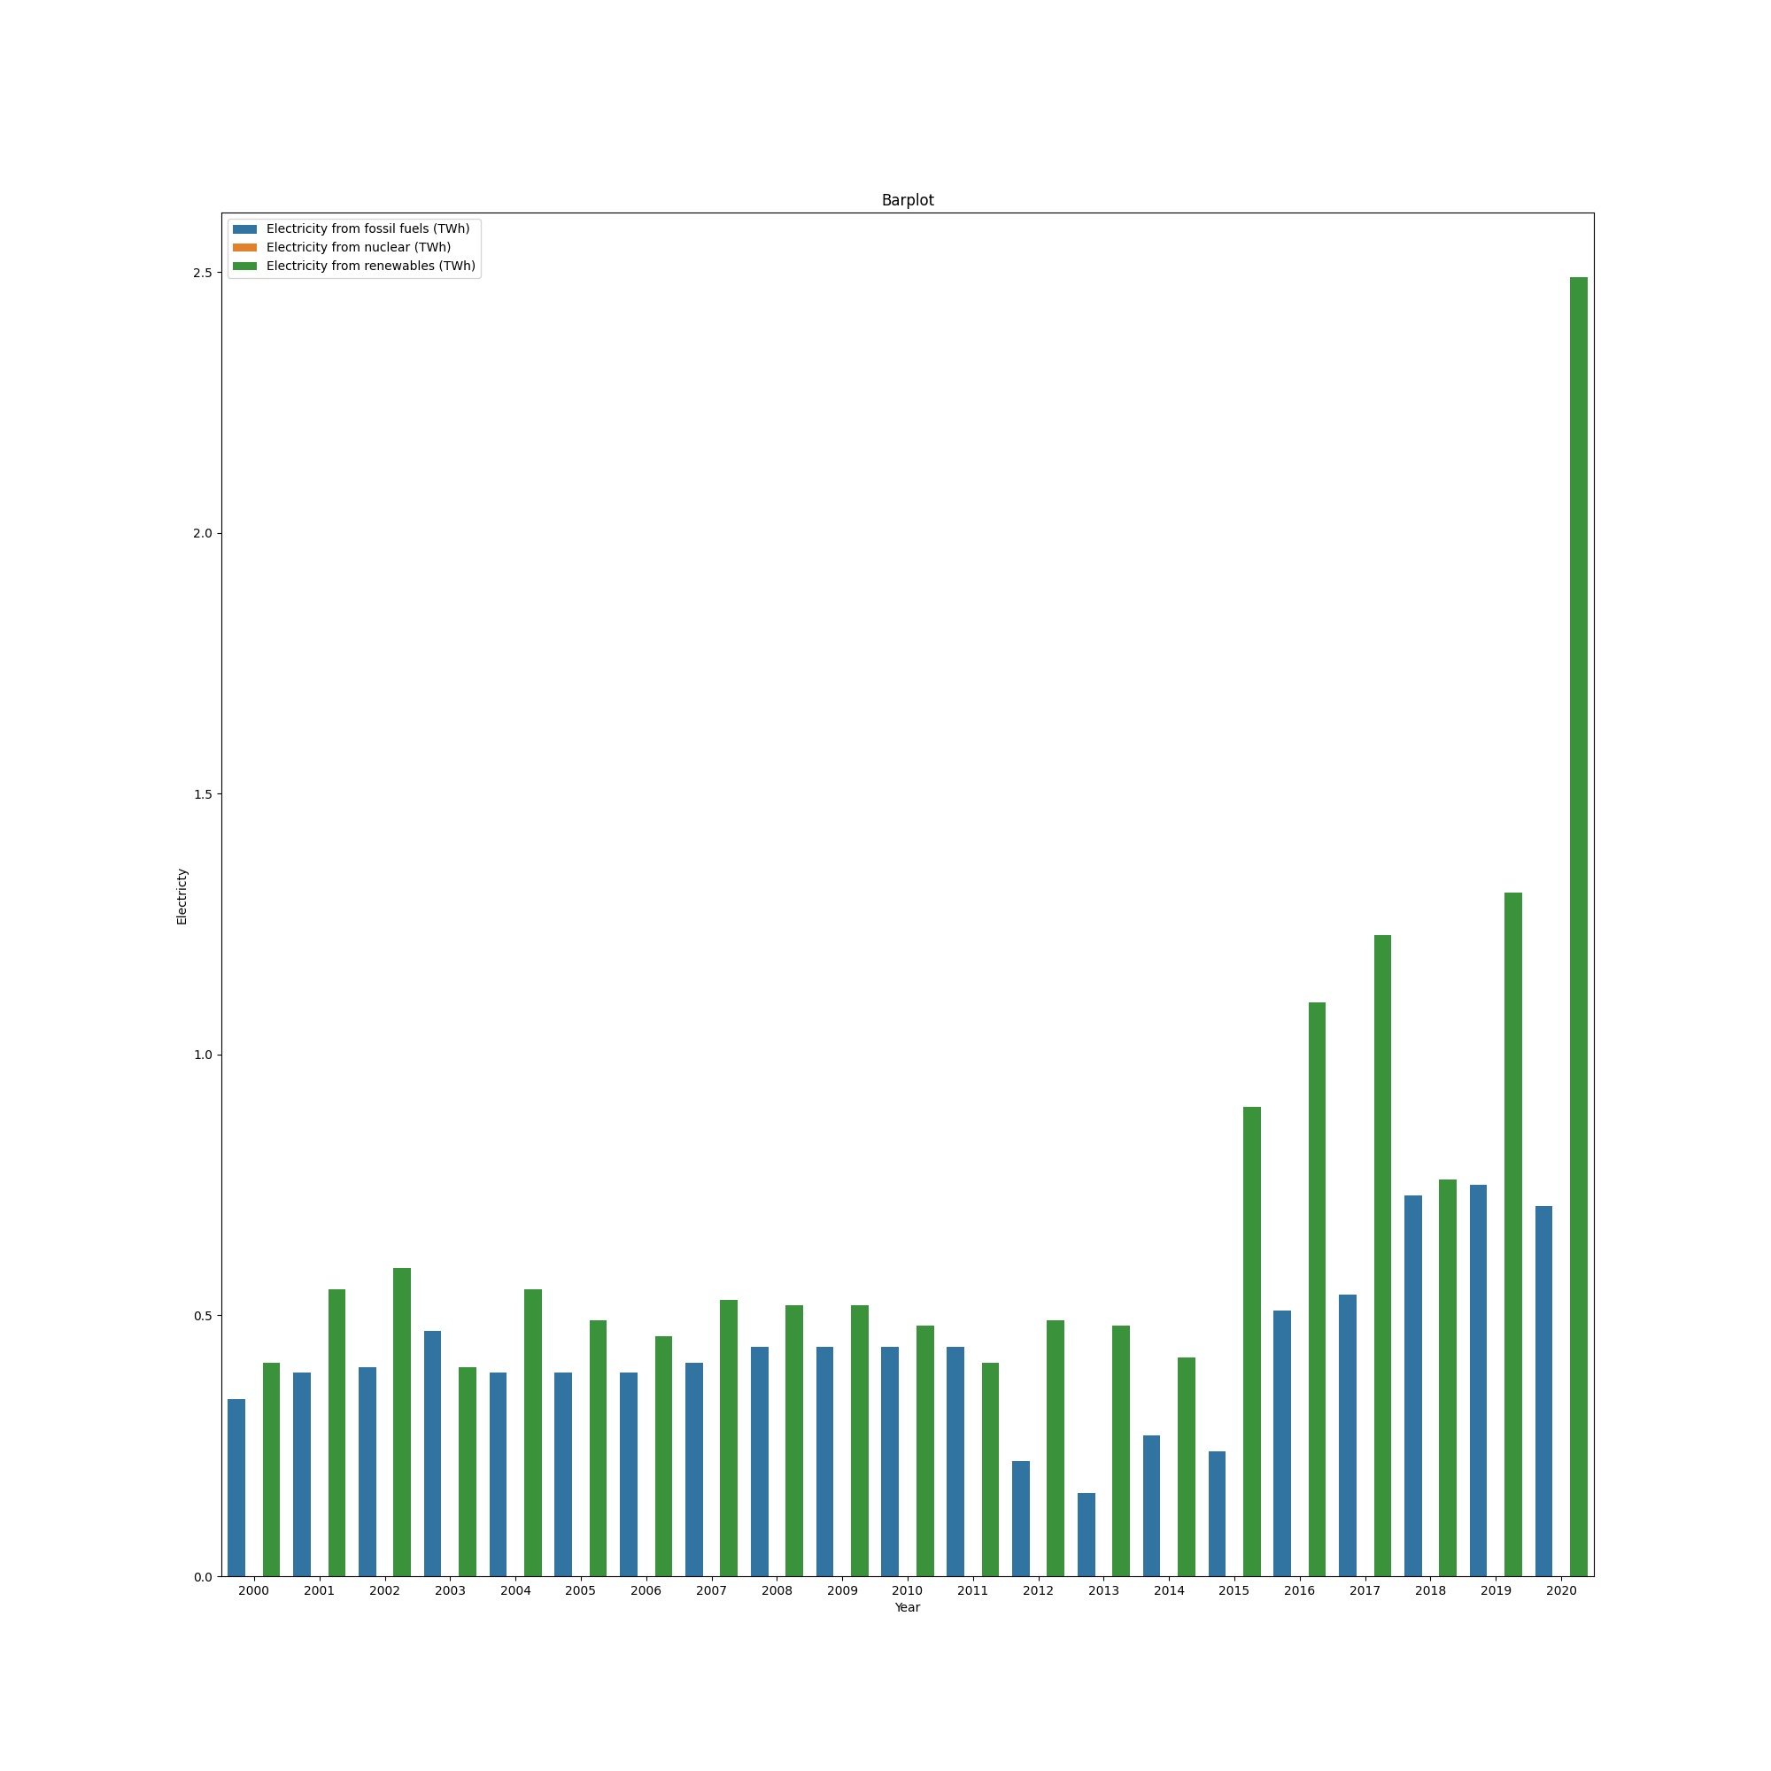
Bar Graphs of Nations: COUNTRIES WITH BEST AND WORST HDI RANKINGS
NORWAY SWITZERLAND AUSTRALIA
NIGER YEMEN GUINEA

Slide 11
ANALYSIS OF GRAPHS
Electricity Generation by Source:
The bar plots display electricity generation from fossil fuels, nuclear, and renewables across different years.
For many entities, electricity generation from fossil fuels remains dominant, but there is a noticeable rise in renewable energy production.
Some entities also have significant contributions from nuclear energy.
Generally, countries with high HDI scores tend to have higher renewable energy usage. These countries often have more resources and technology to invest in renewable energy infrastructure.
In contrast, countries with lower HDI scores might rely more on non-renewable energy sources due to economic constraints and lack of infrastructure.

Slide 12
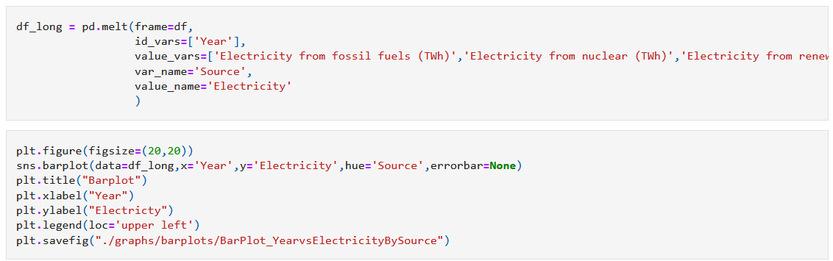
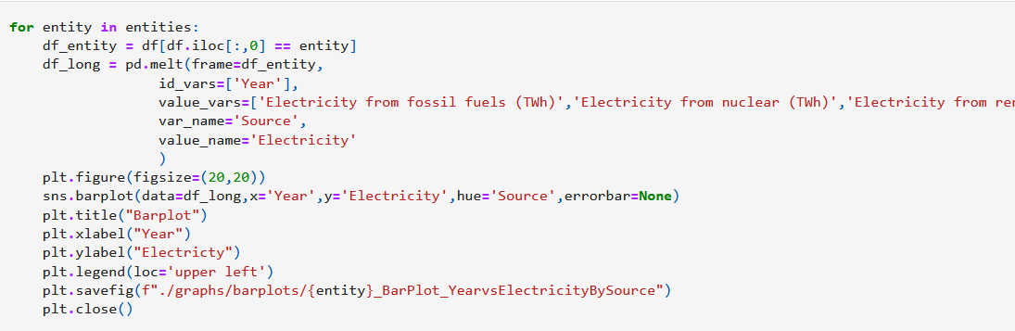
CODE WRITTEN

Slide 13
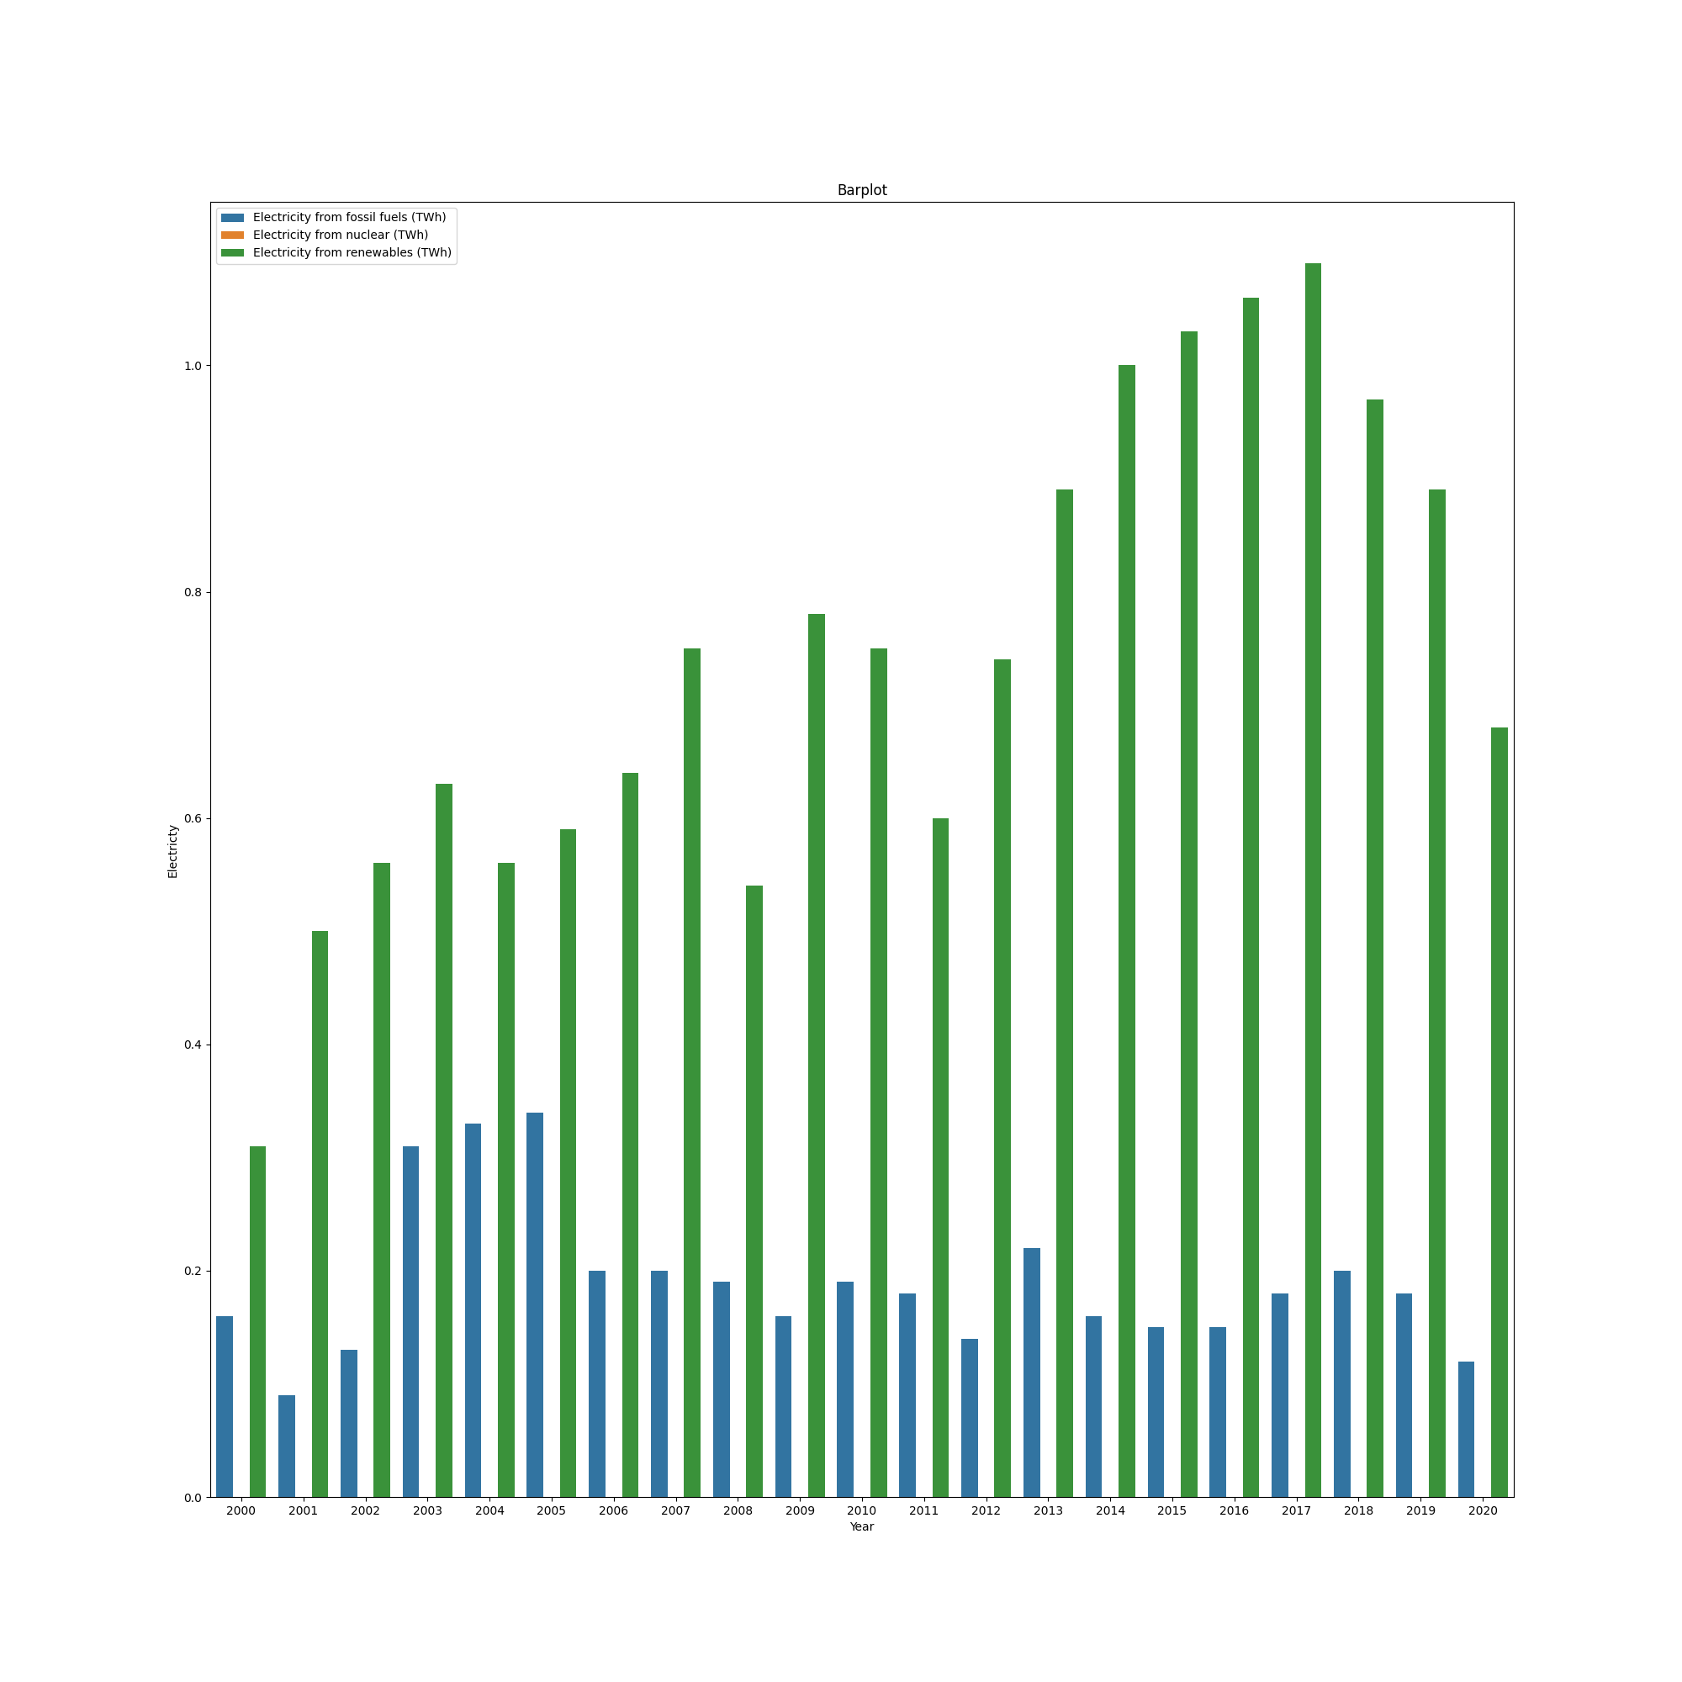
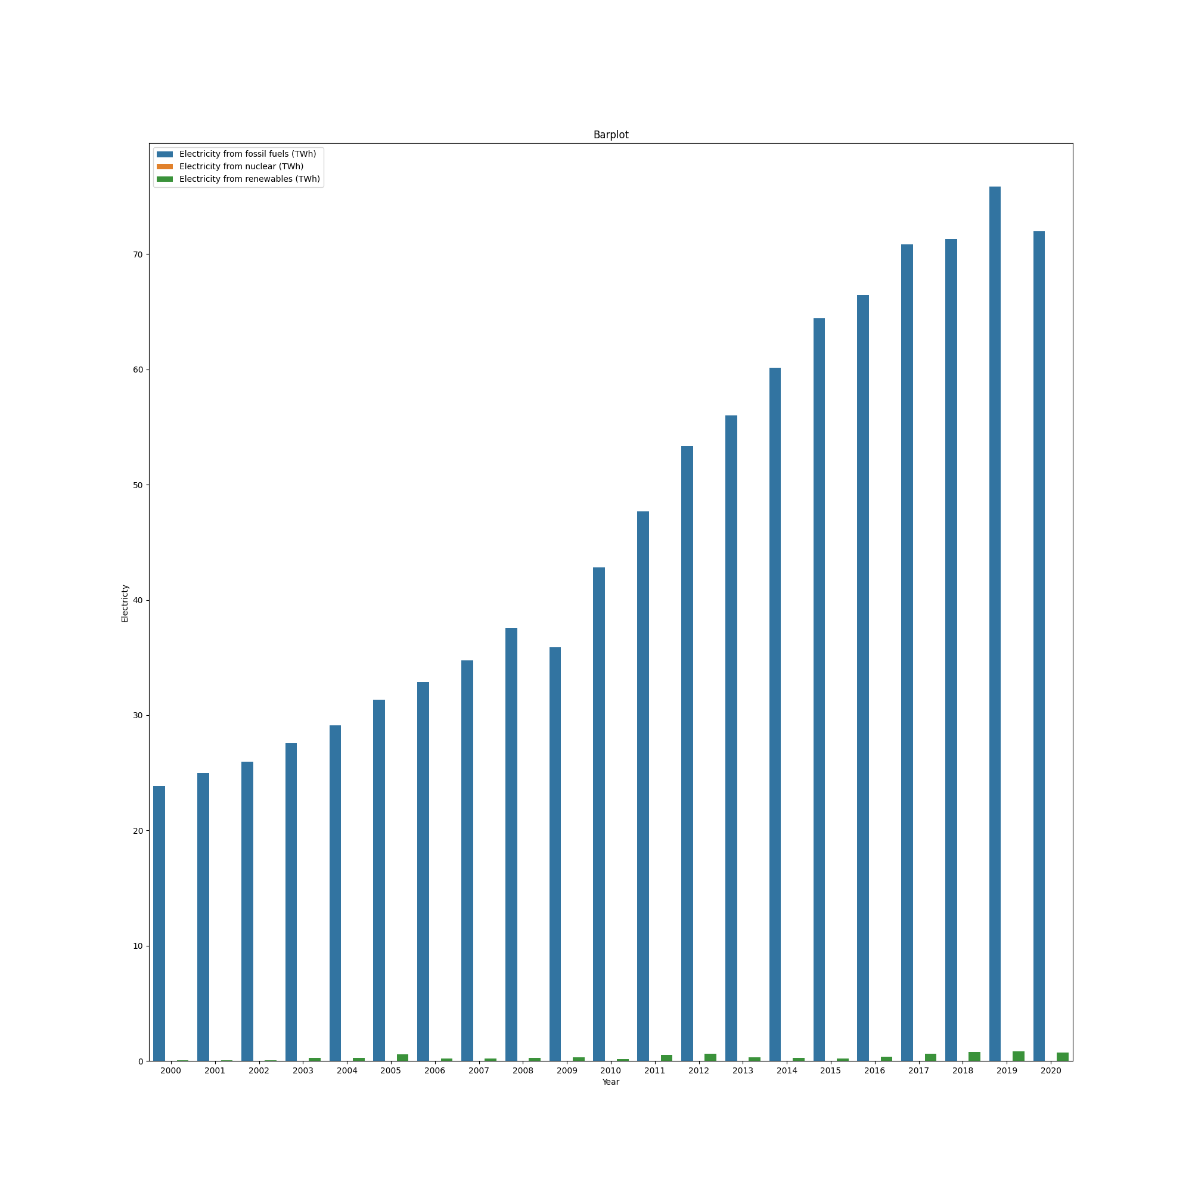
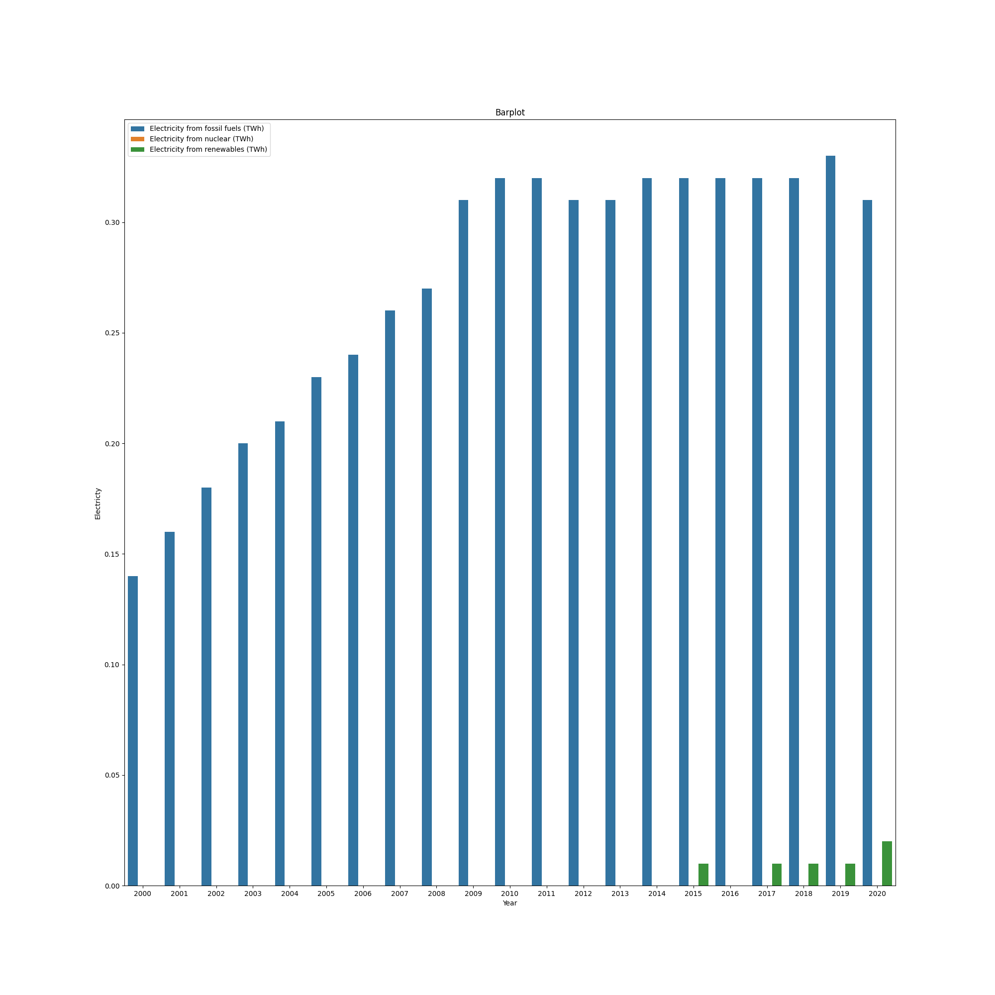
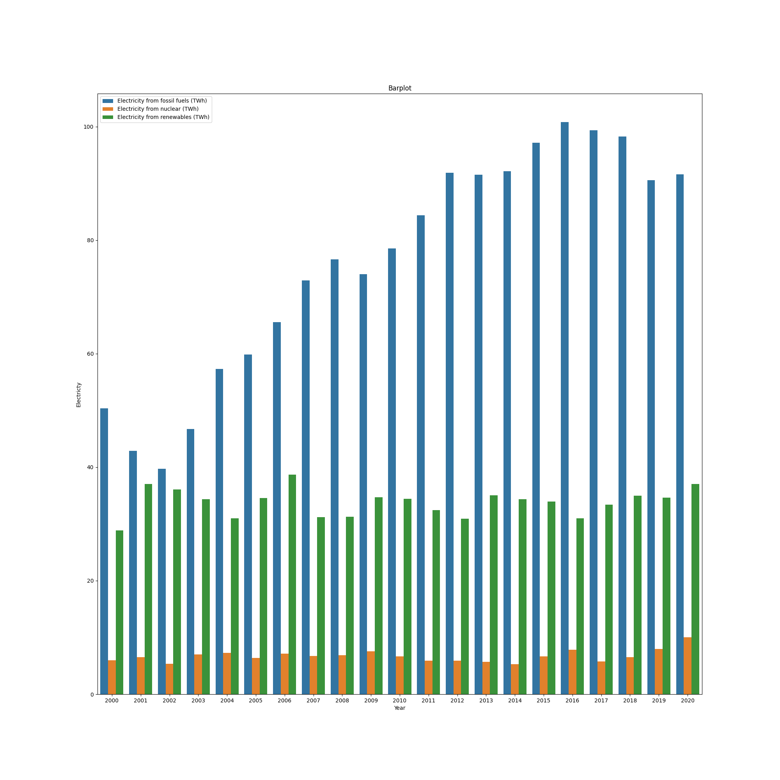
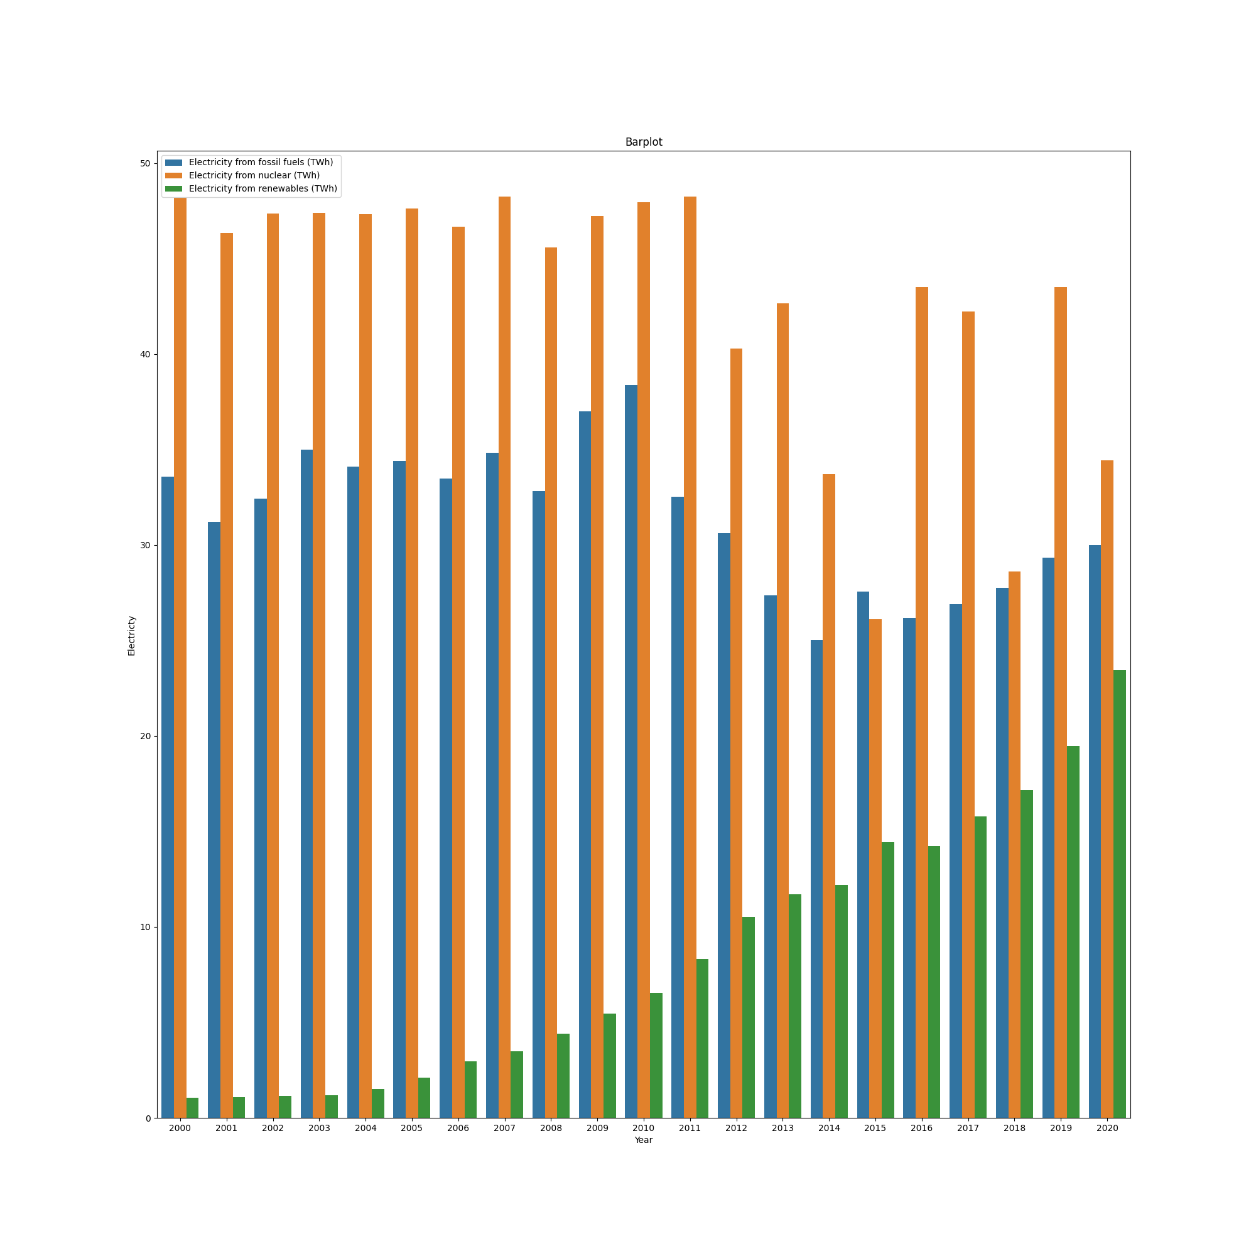
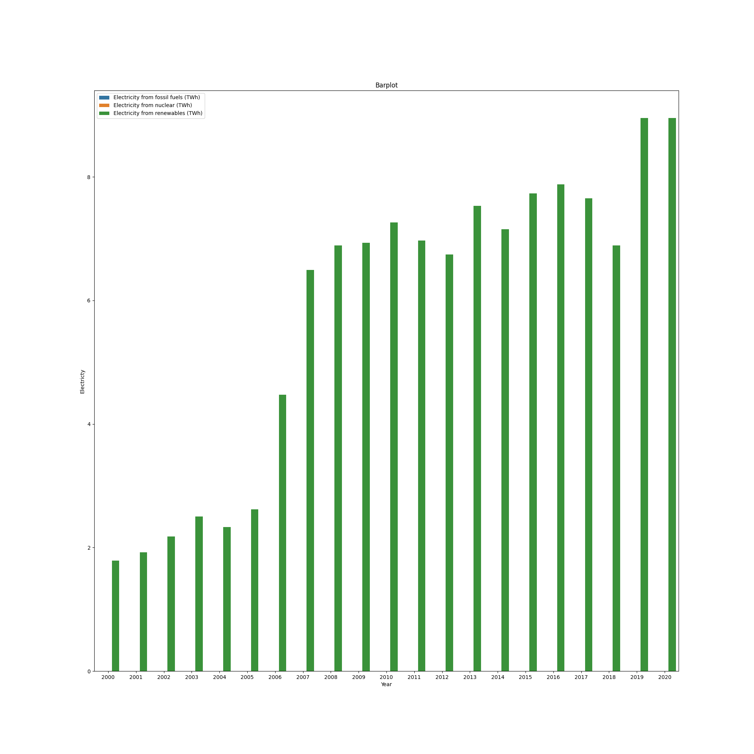
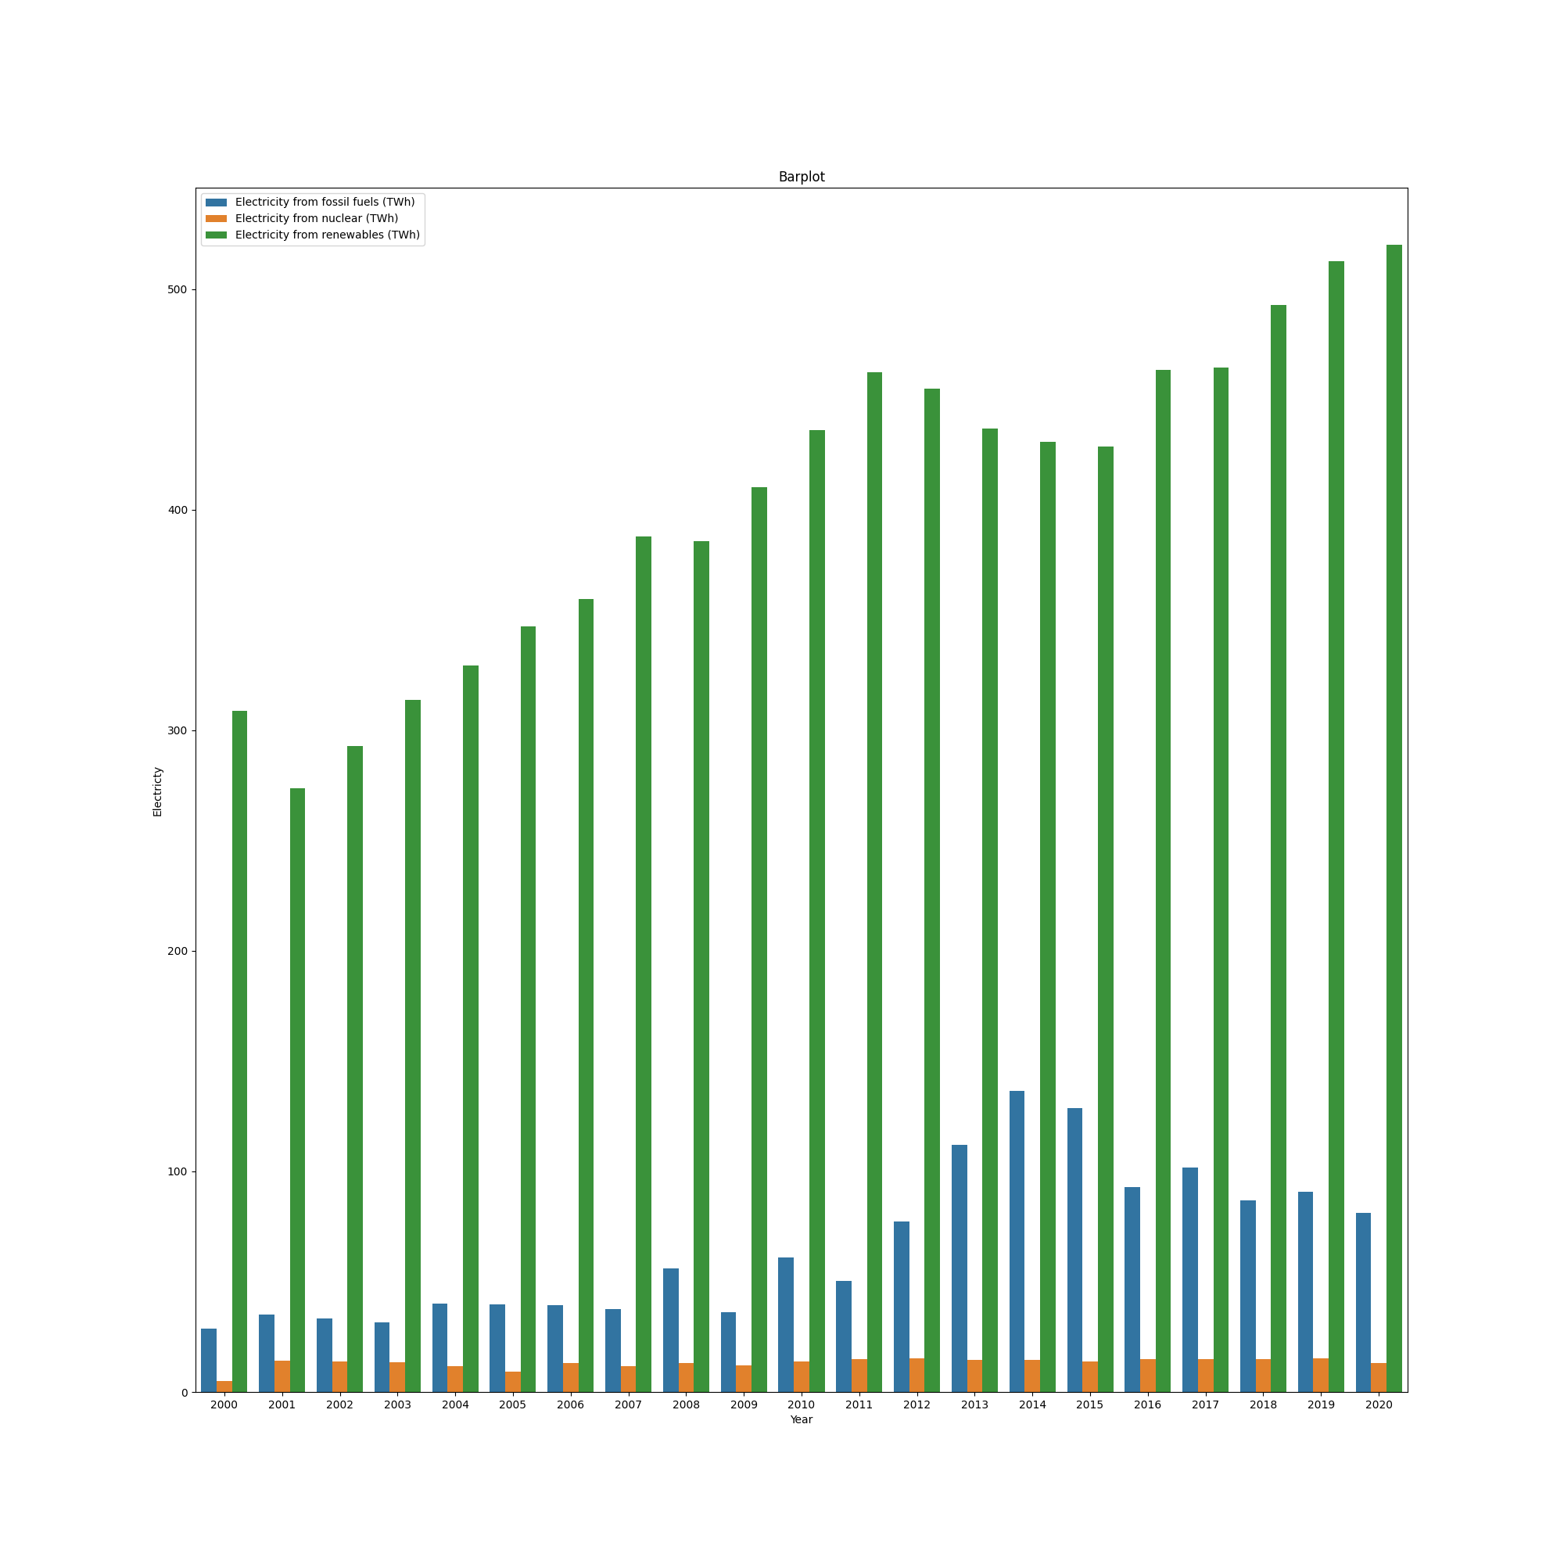
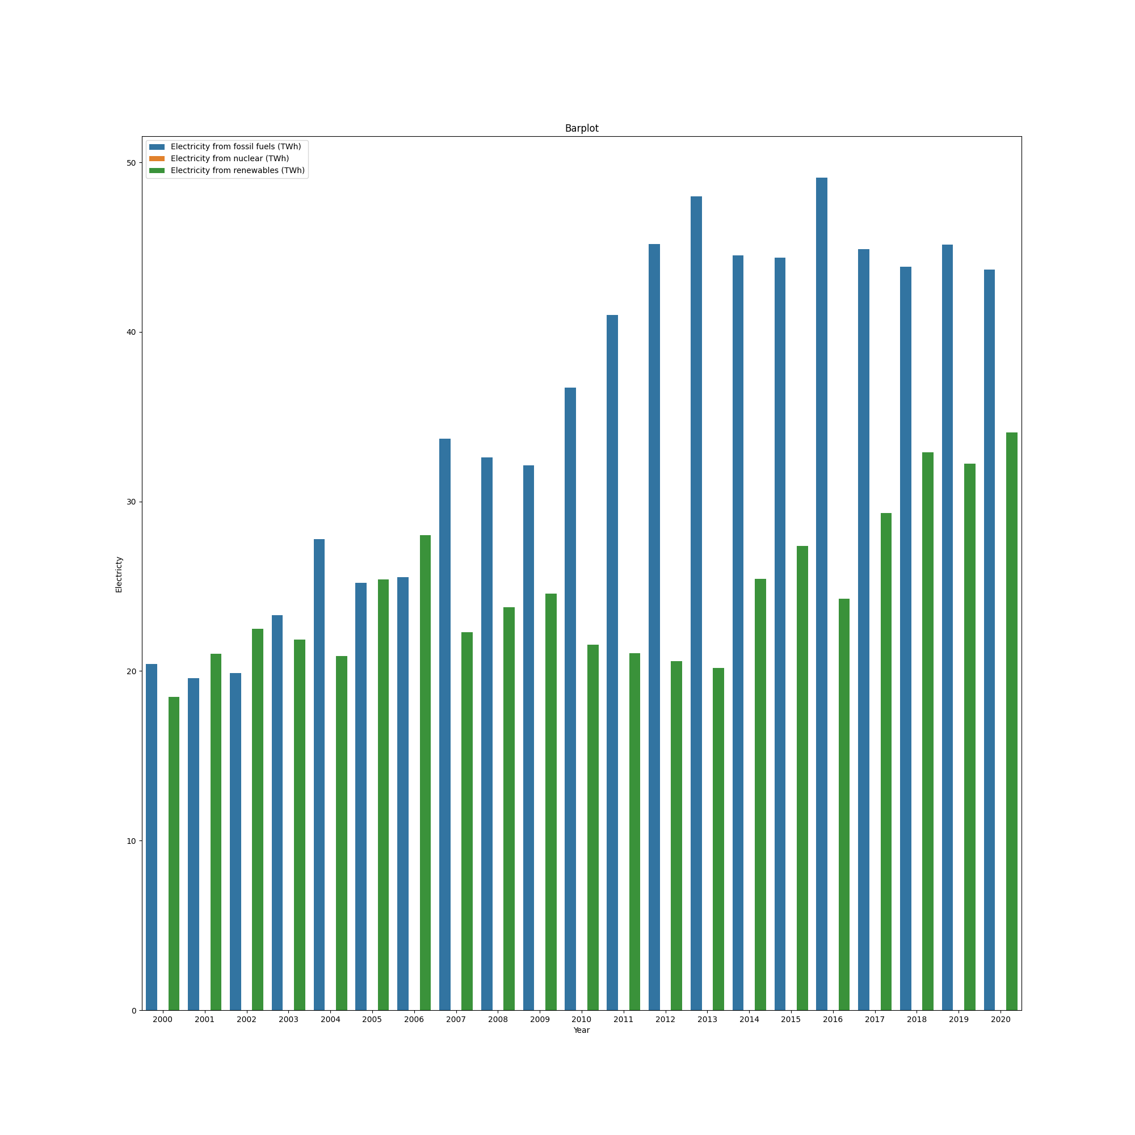
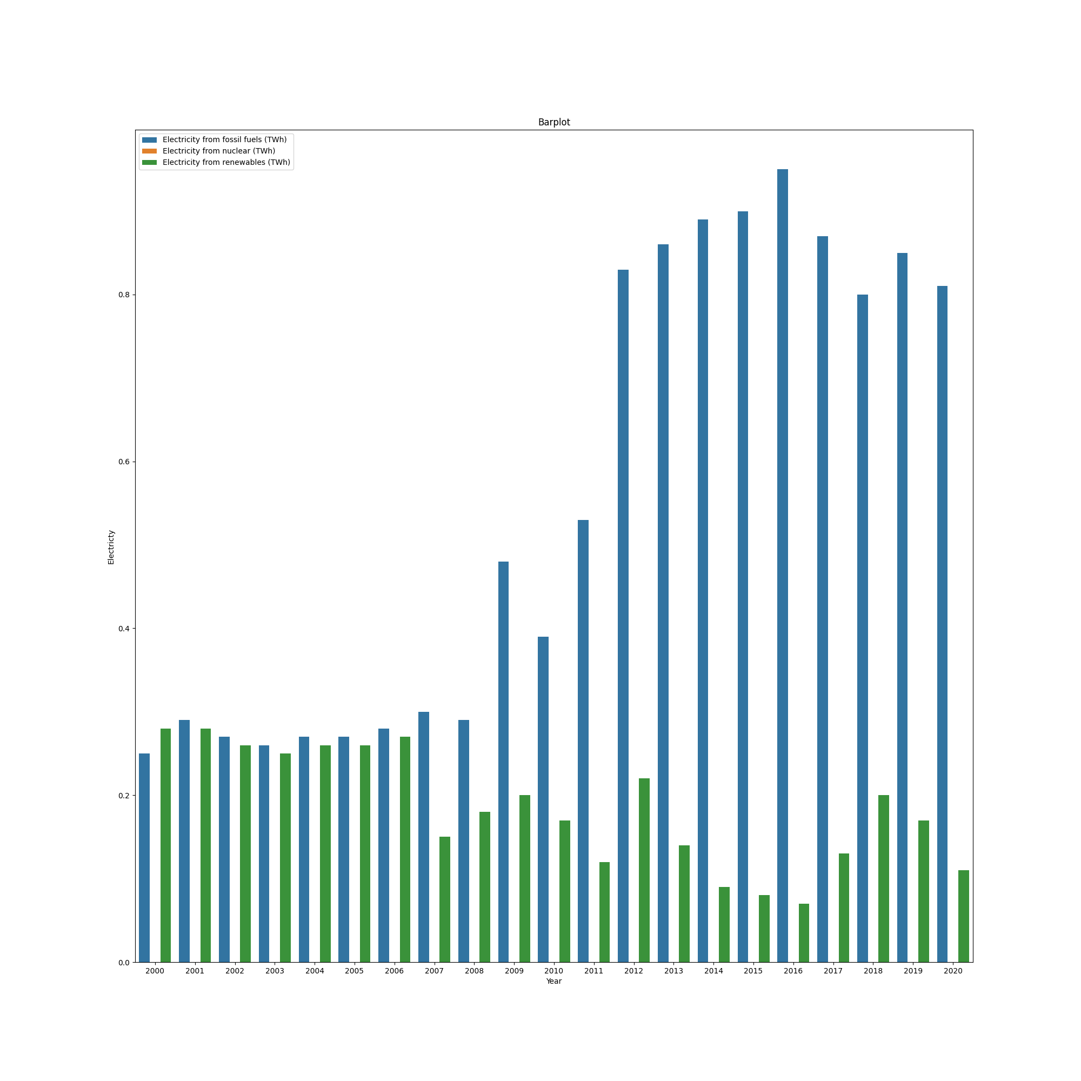
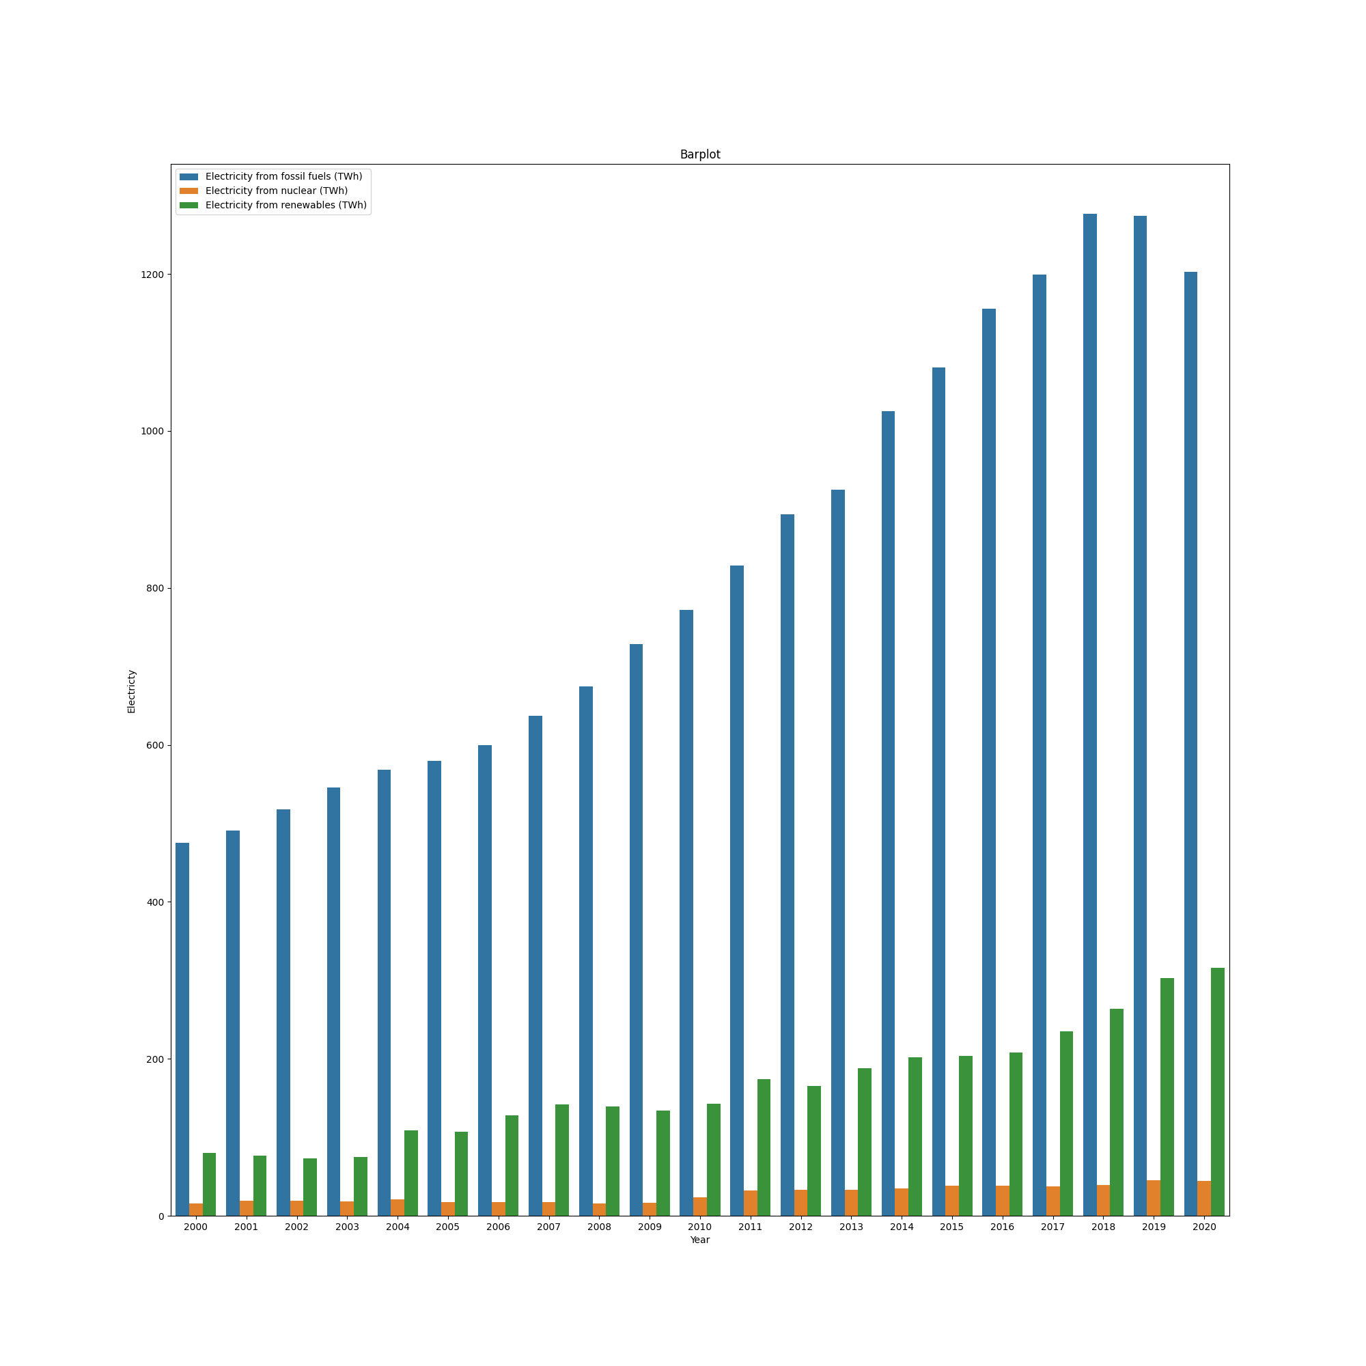
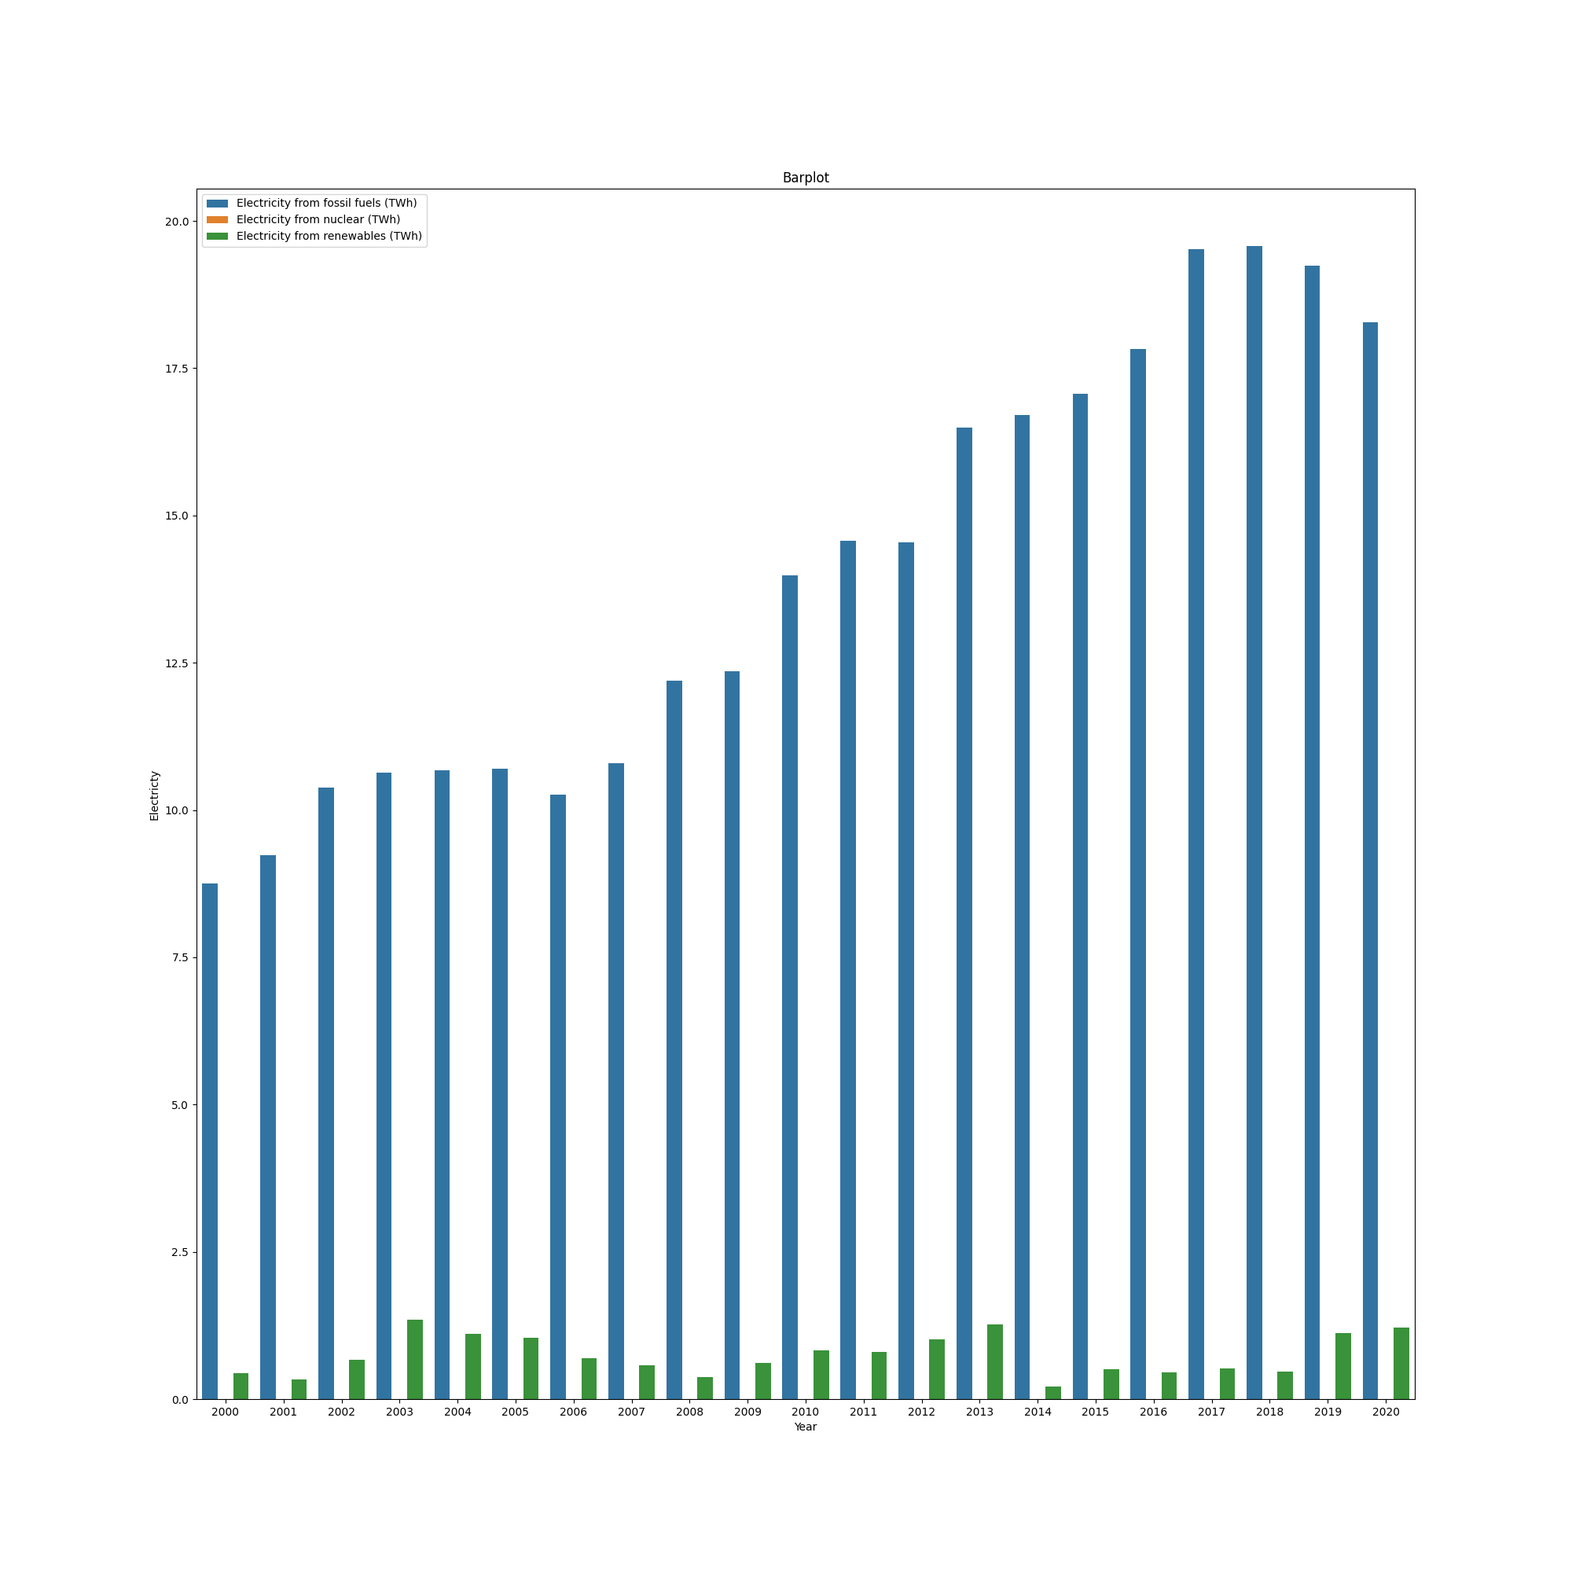
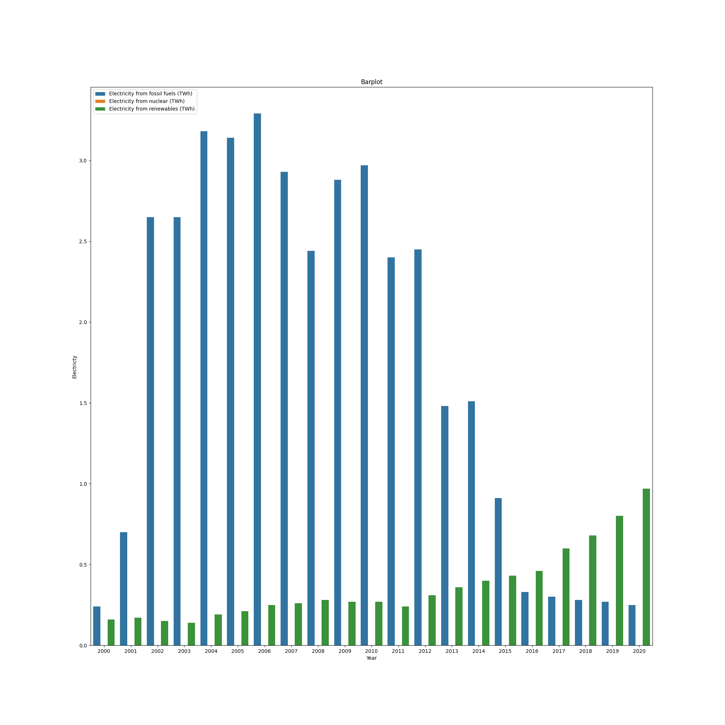
SOME MORE ENERGY DISTRIBUTIONS
GUESS WHICH ONE IS INDIA’S ? HINT: IN THE BOTTOM ROW

Slide 14
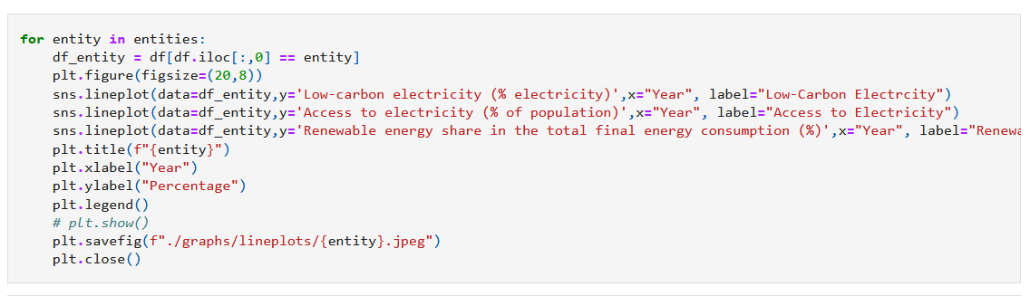
TIME SERIES ANALYSIS
CODE
This plot the Lineplot using Seaborn library.
The graph includes:
the year vs Low Carbon Electricity %
year vs access to electricity
year vs renewable energy share in final consumption
USAGE:
It is a powerful statistical technique used across various fields to analyze time-ordered data for understanding patterns and making forecasts.
This versatility makes time series analysis essential for informed decision-making based on historical data.
In energy, it predicts electricity demand and renewable energy generation patterns.

Slide 15
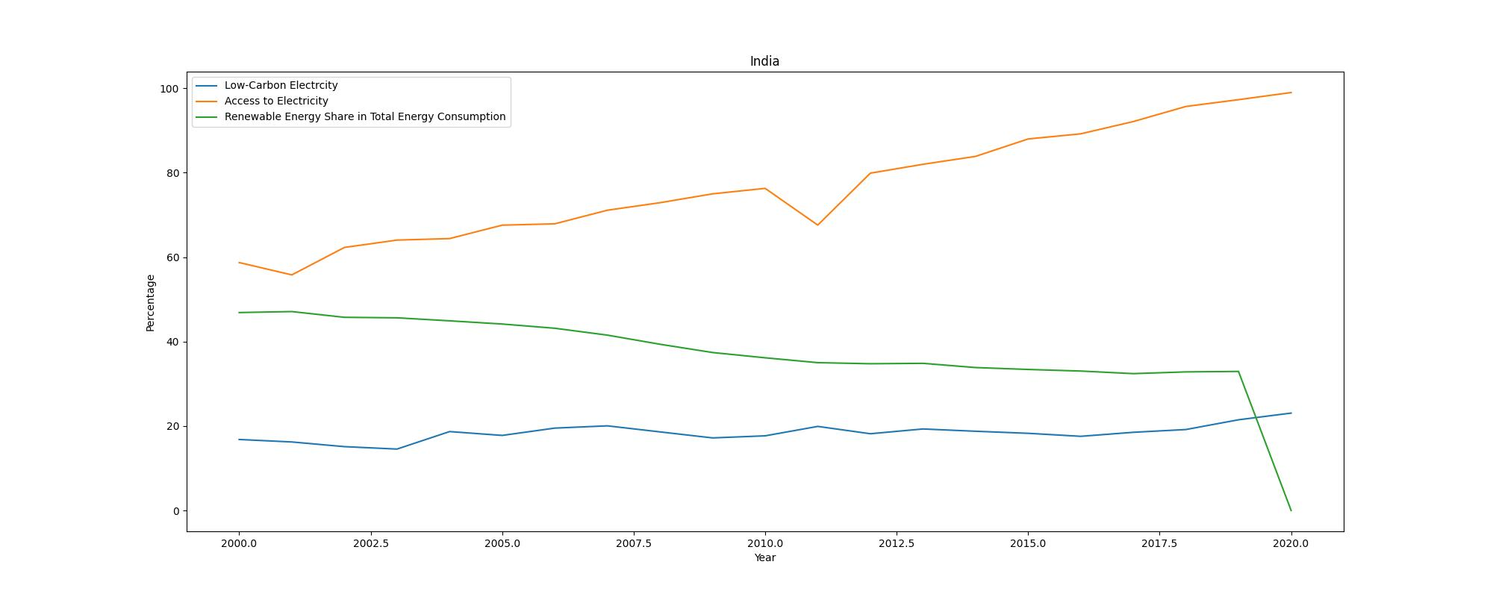
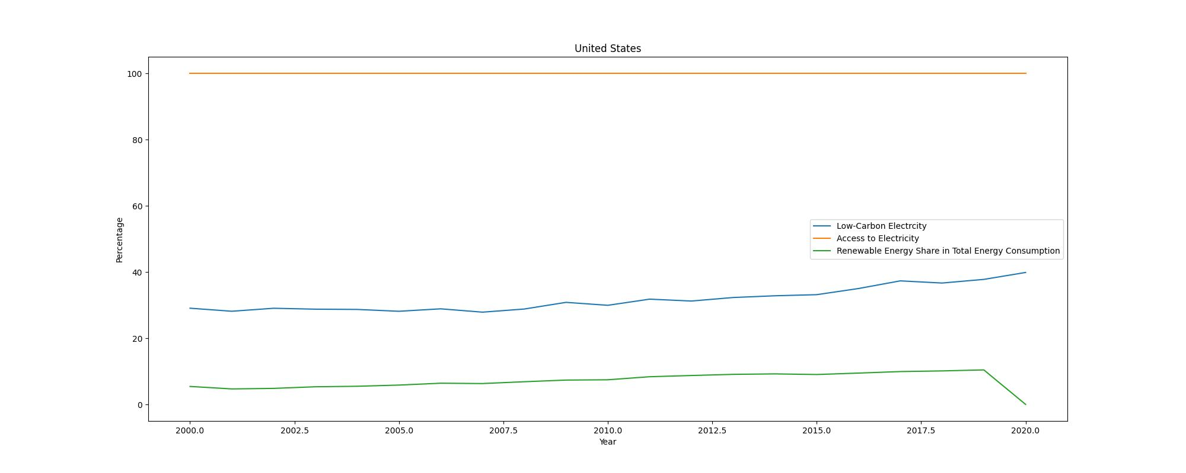
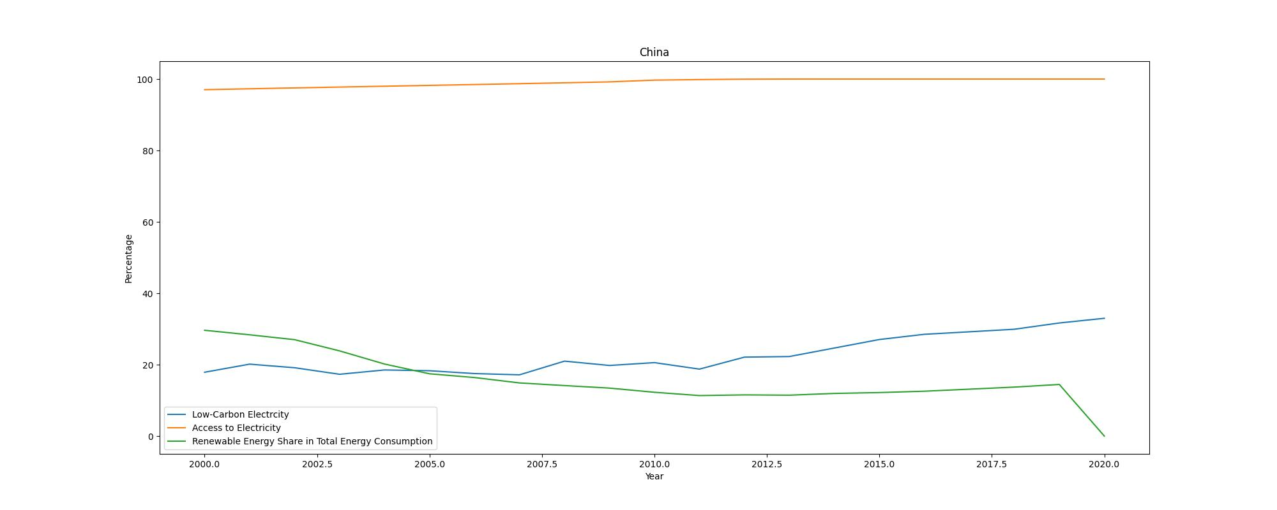
ANALYSIS
The line plots show the trends of access to electricity, renewable energy share in total energy consumption, and low-carbon electricity percentage over the years for various entities.
Most entities have shown a significant increase in access to electricity over time.
The share of renewable energy in total energy consumption has also generally increased, indicating a shift towards cleaner energy sources.
The percentage of low-carbon electricity has varied across entities but shows an overall positive trend, highlighting efforts to reduce carbon emissions from electricity generation.
INDIA
UNITED STATES
CHINA

Slide 16
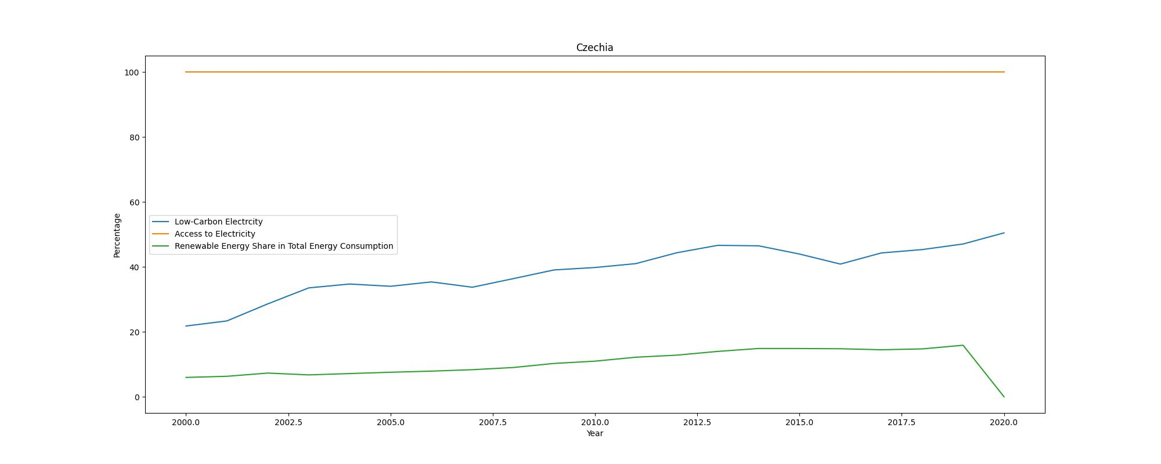
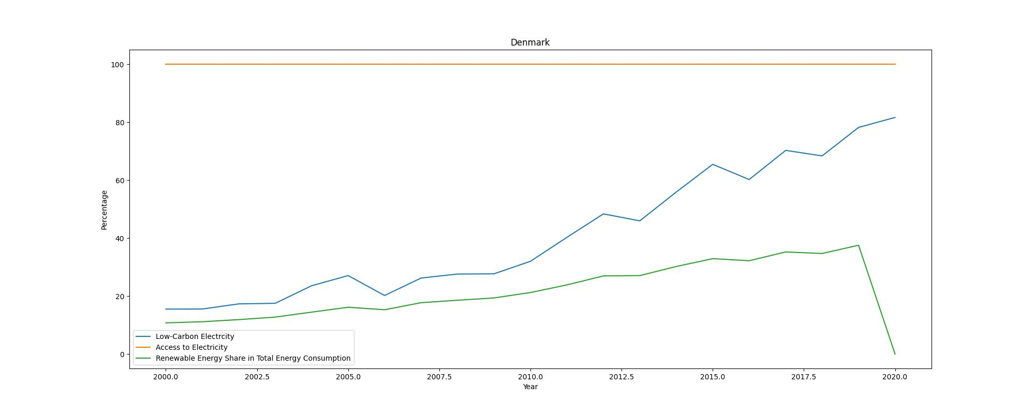
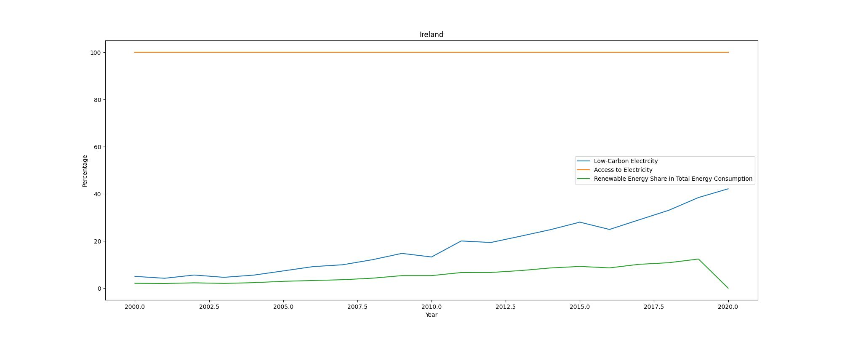
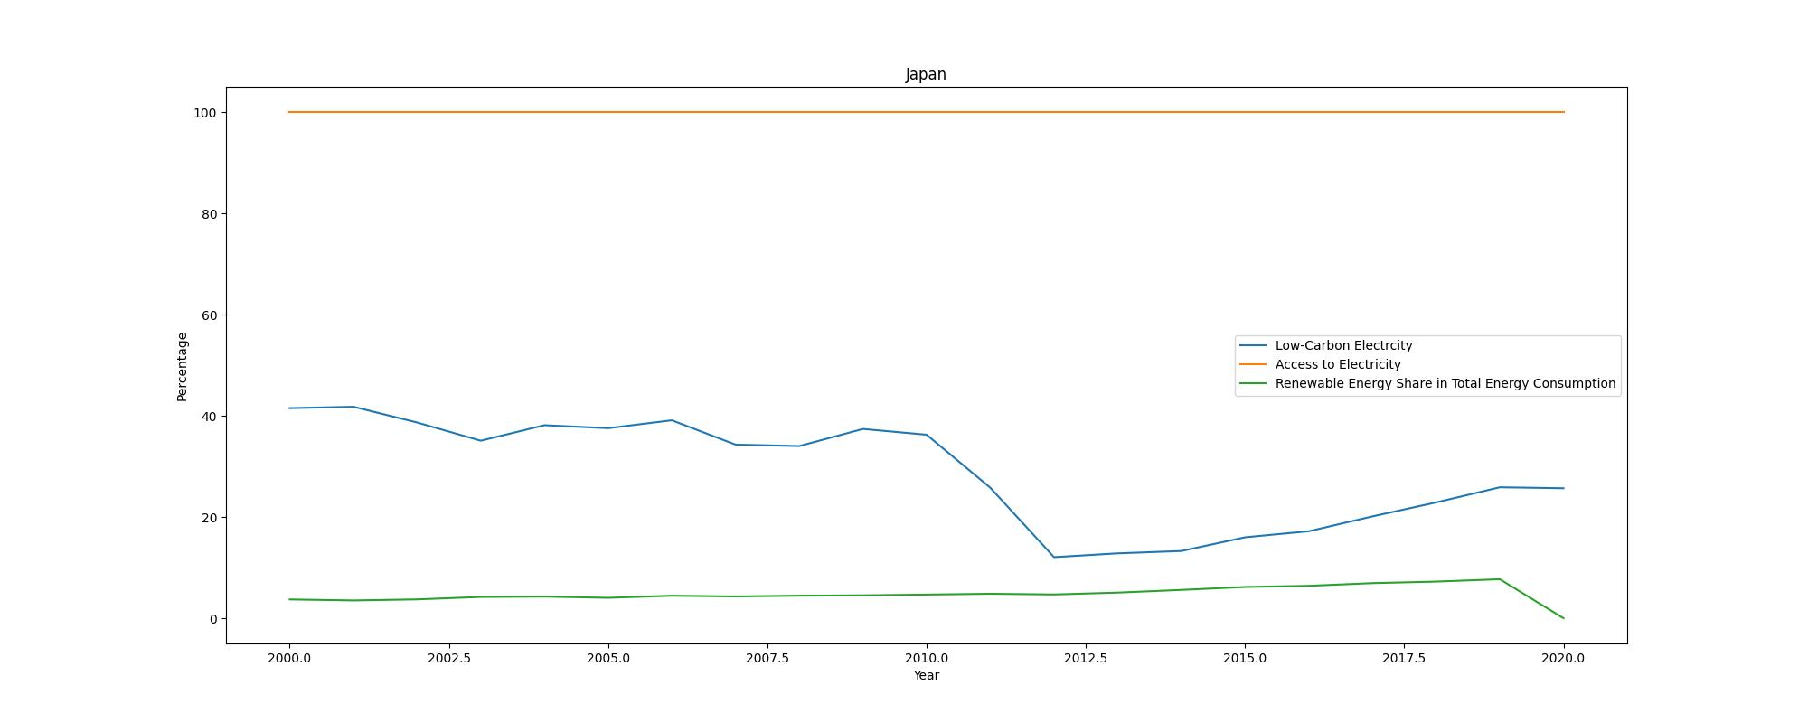
SOME MORE LINE PLOTS
CZECHIA DENMARK
IRELAND JAPAN
Cont.

Slide 17
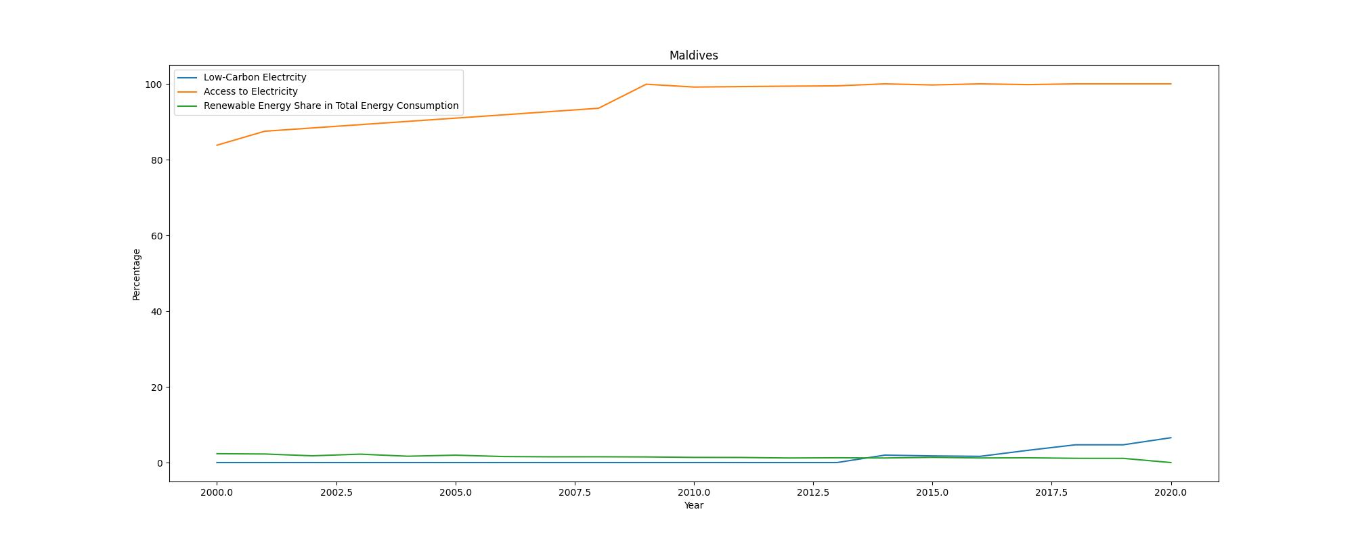
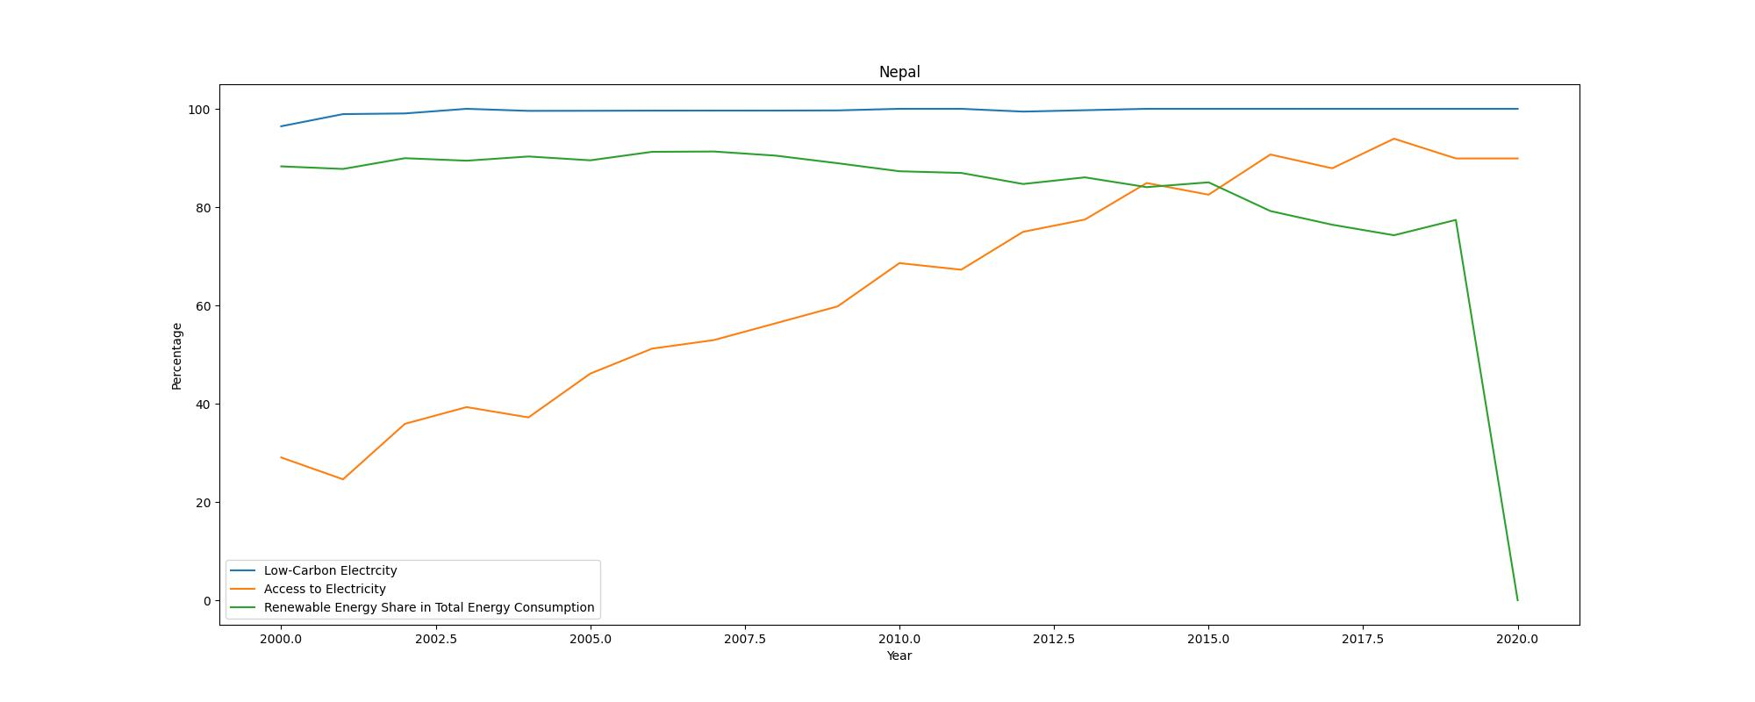
SOME MORE LINE PLOTS
MALDIVES NEPAL
SENEGAL SURINAME

Slide 18
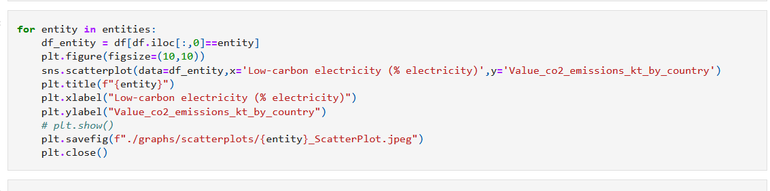
SCATTERPLOTS
CODE
Scatter plots are essential tools in data analysis, used to visualize the relationship between two numerical variables by displaying data points on a Cartesian plane.
Each point represents an observation, with one variable on the x-axis and the other on the y-axis. Scatter plots help identify patterns, trends, clusters, and outliers, and they are particularly useful for visually assessing the correlation between variables, whether positive, negative, or nonexistent.
They are widely used across various fields, including finance, healthcare, and social sciences, to gain insights from data and make informed decisions.
Creating scatter plots is straightforward with tools like Matplotlib in Python, allowing for clear and effective data visualization.
Low-Carbon Electricity vs. CO2 Emissions:
The scatter plots illustrate the relationship between low-carbon electricity percentages and CO2 emissions for different entities.
Generally, there is an inverse relationship where entities with higher percentages of low-carbon electricity tend to have lower CO2 emissions.
This indicates the positive impact of adopting low-carbon energy sources in mitigating climate change.

Slide 19
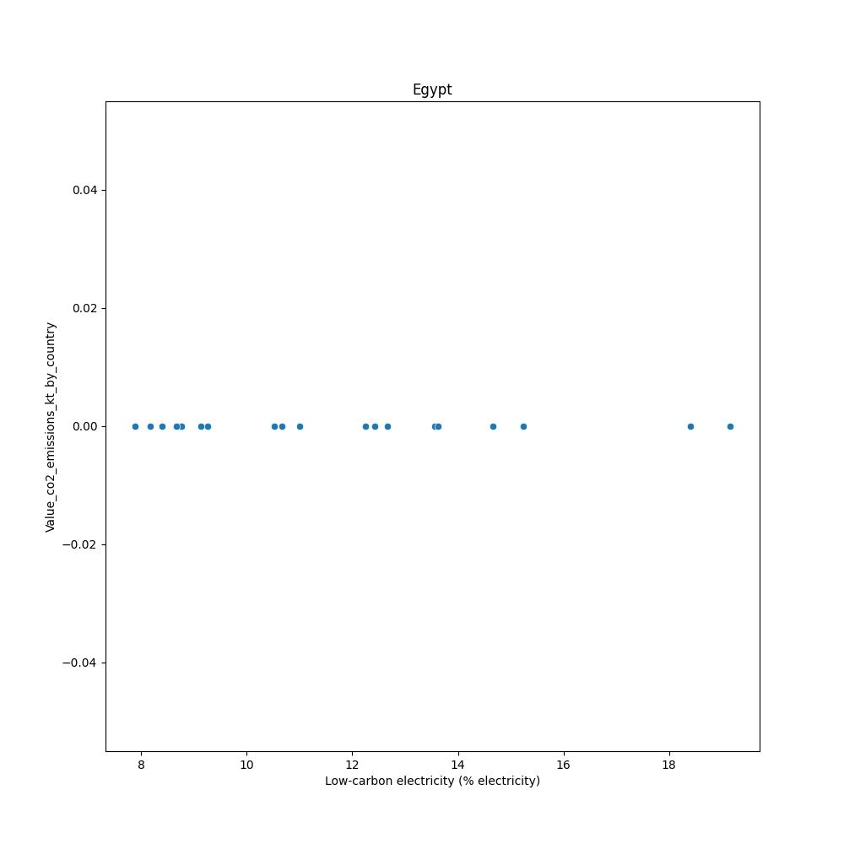
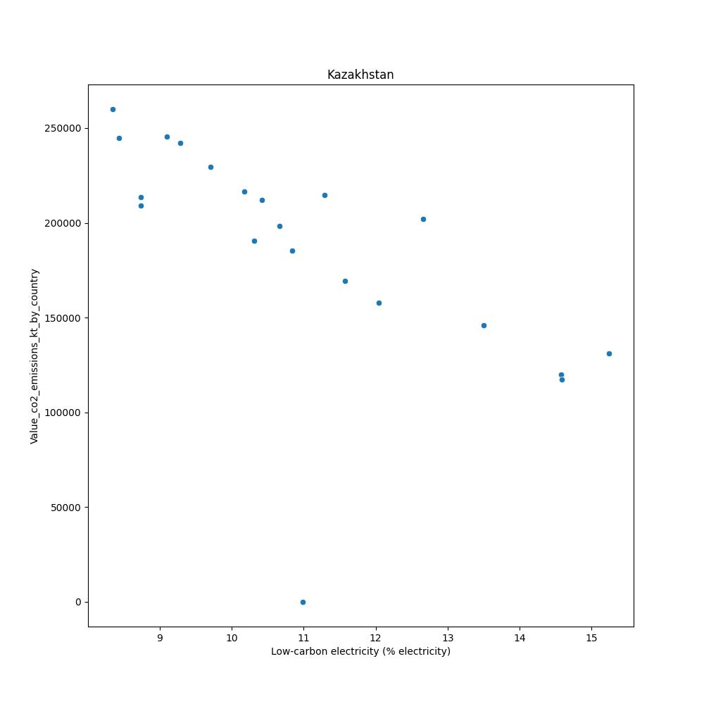
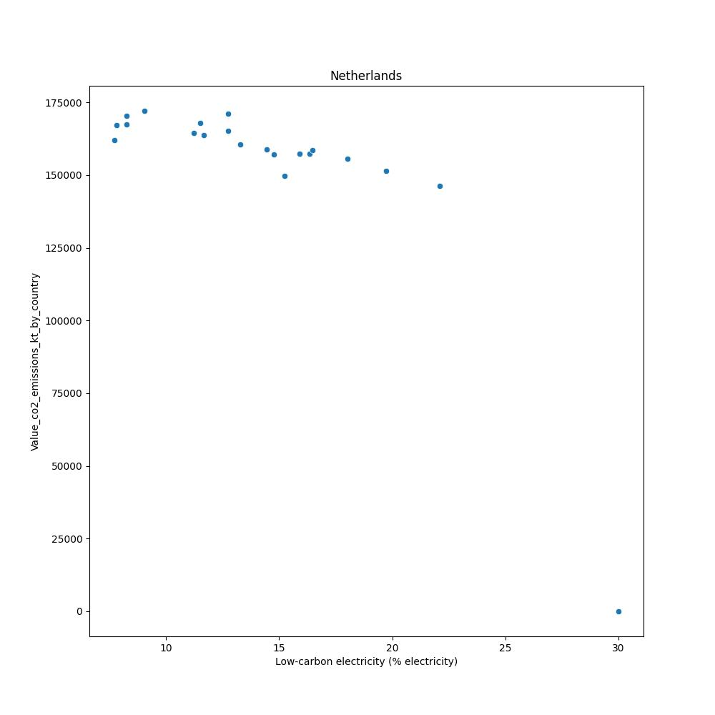
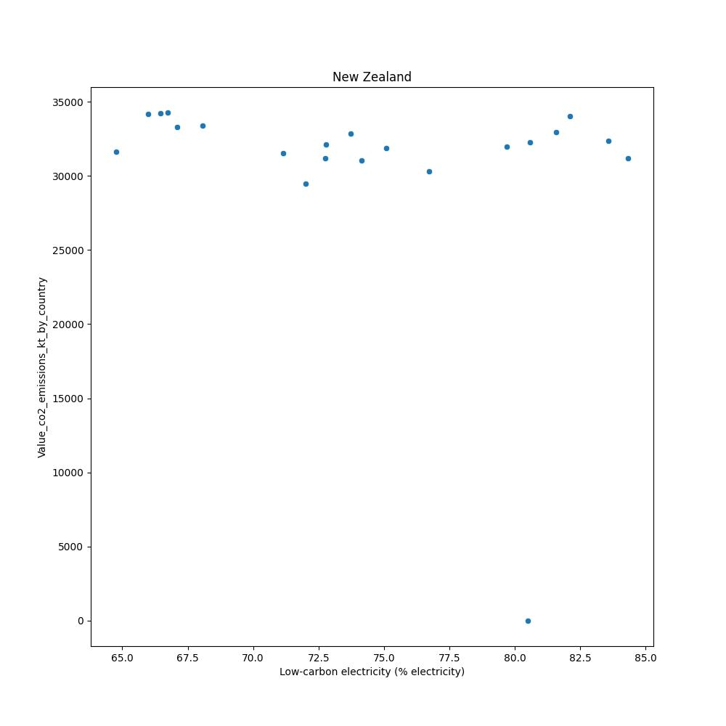
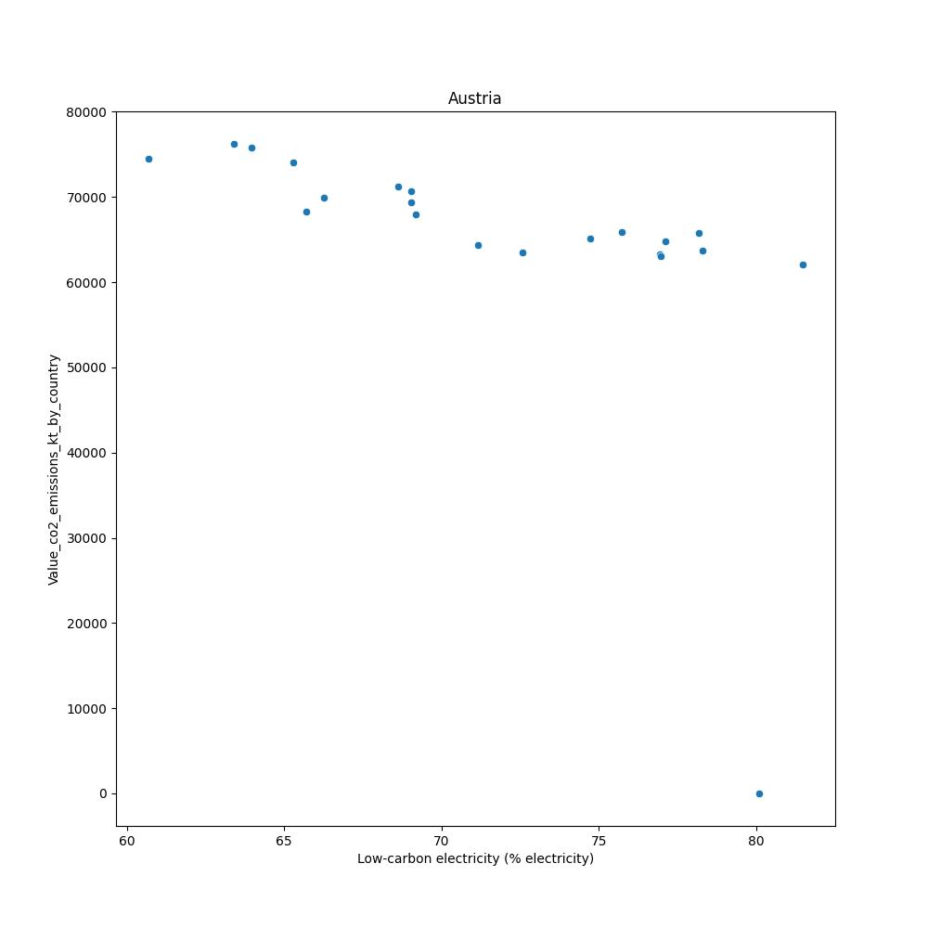
SCATTERPLOTS OF DIFFERENT NATIONS
EGYPT KAZAKHSTAN NETHERLANDS
NEW ZEALAND AUSTRIA

Slide 20
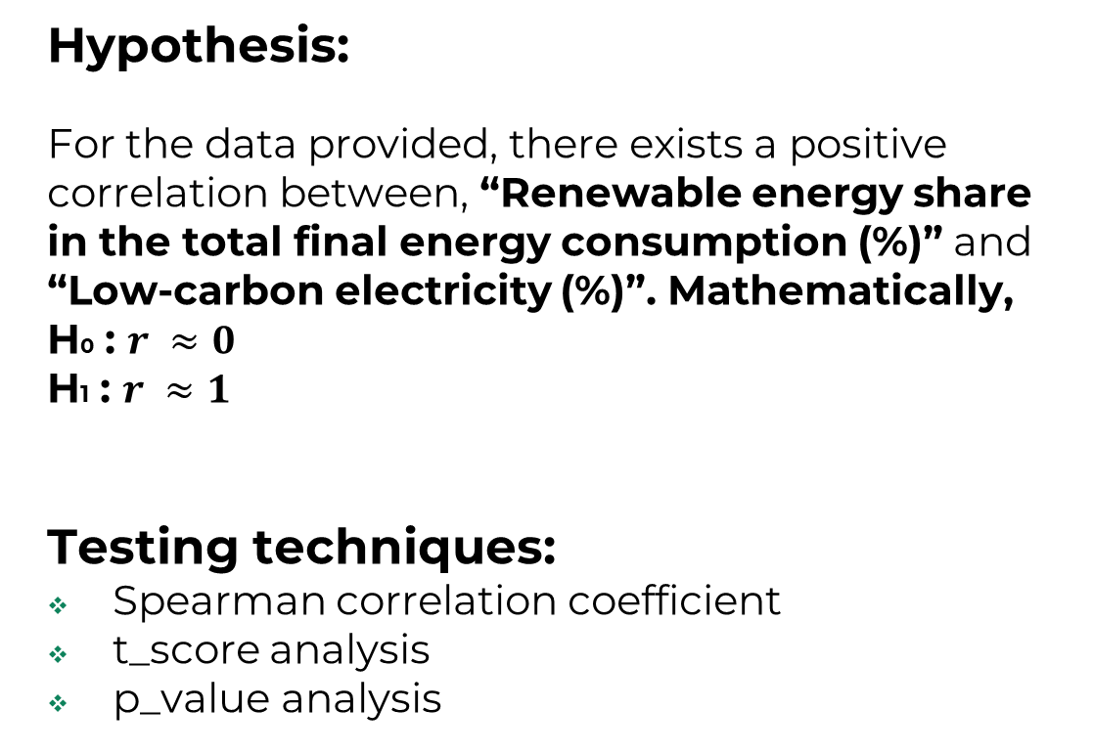
HYPOTHESIS DEVELOPMENT & TESTING
Hypothesis:
For the data provided, there exists a positive correlation between, “Renewable energy share in the total final energy consumption (%)” and “Low-carbon electricity (%)”. Mathematically,
H0 : $r ≈0$
H1 : $r ≈1$
Testing techniques:
Spearman correlation coefficient
t_score analysis
p_value analysis

Slide 21
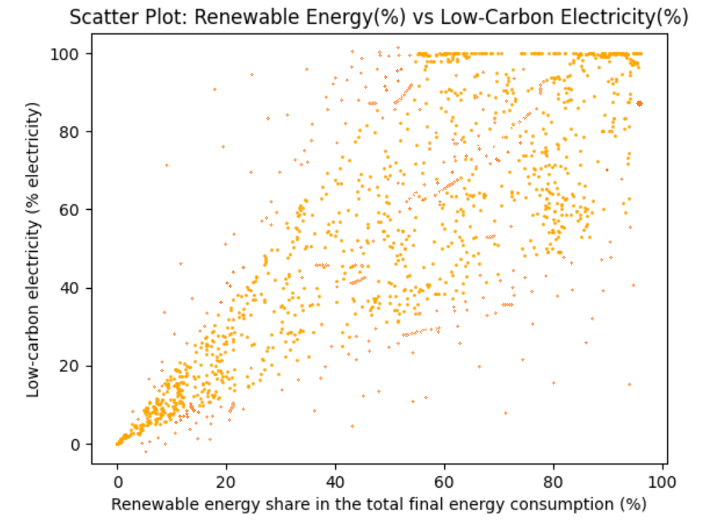
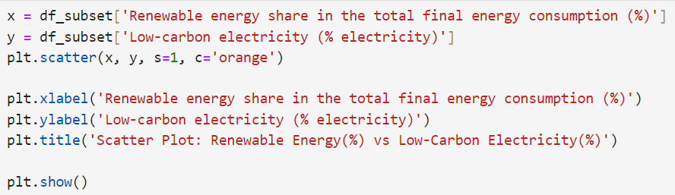
Scatter plot of “Renewable energy share in the total final energy consumption” V/S “Low-carbon electricity”
Insights:
The goal of this hypothesis test was to analyze and understand the correlation between renewable energy and low carbon electricity.
The relationship is also evident in this scatter plot which shows them to have a linear positive correlation.
Spearman coefficient was used as the distribution is not Normal but was made from a vast dataset.
Results:
Spearman Correlation coefficient = 0.8712
T_score = 60.3224
P_value = 0.000

Slide 22
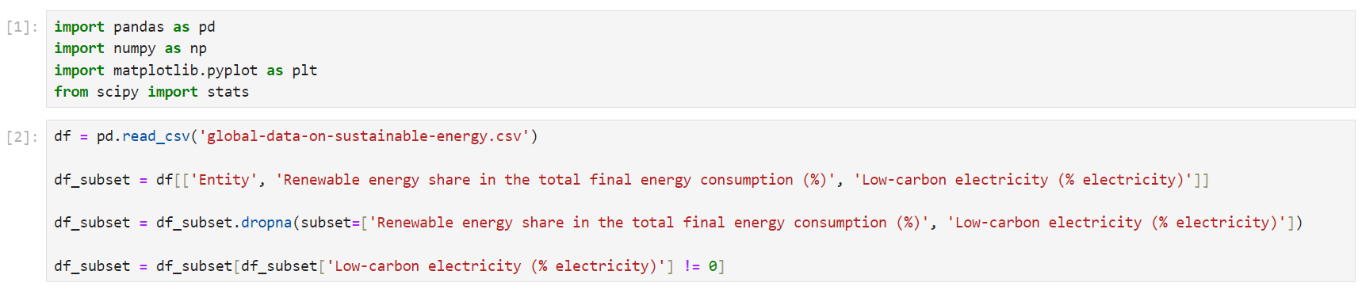
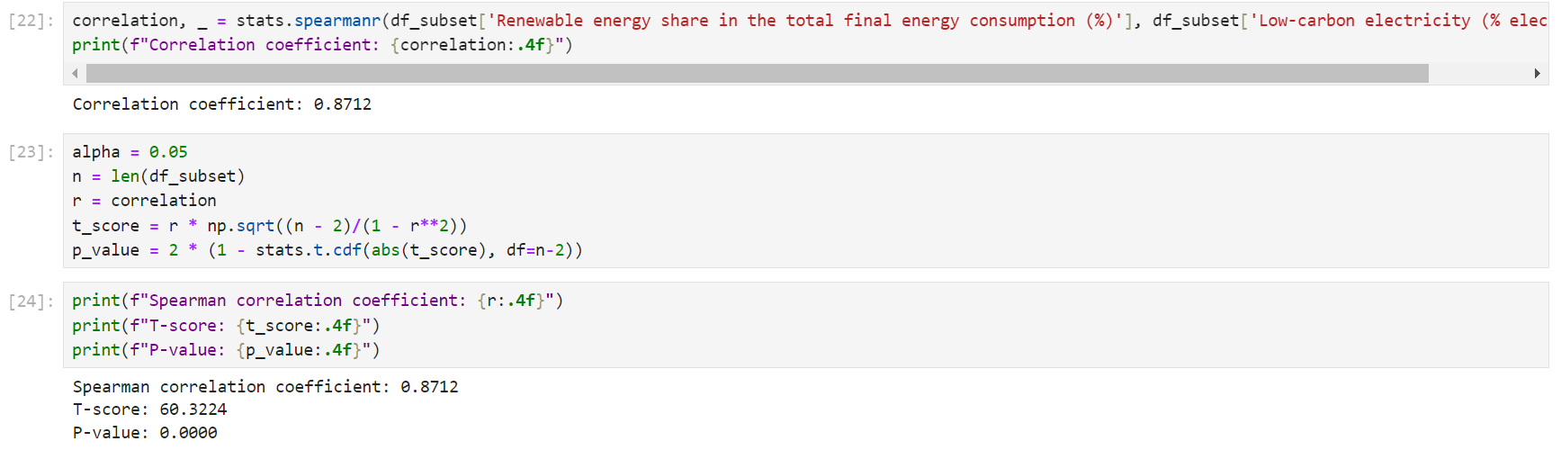
Data Preprocessing and Calculation of coefficients for correlation analysis

Slide 23
Interpretation of Results
Correlation Coefficient:
Value: The correlation coefficient (r = 0.8712) indicates a strong positive linear relationship between renewable energy and low carbon electricity.
Significance: As renewable energy increases, low carbon electricity tends to increase, supporting the hypothesis of a positive correlation.
T-Score:
Value: The t-score (t_score = 60.3224) indicates the strength of the relationship.
Significance: A higher t-score suggests a statistically significant correlation between renewable energy and low carbon electricity.
P-Value:
Value: The p-value (p_value = 0.0000) is very low.
Significance: This indicates a negligible probability of observing such a strong correlation by chance. Therefore, we reject the null hypothesis and conclude there is a significant positive correlation between renewable energy and low carbon electricity.

Slide 24
Conclusion
1. Access to Electricity and Renewable Energy Share:
The line plots show the trends of access to electricity, renewable energy share in total energy consumption, and low-carbon electricity percentage over the years for various entities.
Most entities have shown a significant increase in access to electricity over time.
The share of renewable energy in total energy consumption has also generally increased, indicating a shift towards cleaner energy sources.
The percentage of low-carbon electricity has varied across entities but shows an overall positive trend, highlighting efforts to reduce carbon emissions from electricity generation.
2. Electricity Generation by Source:
The bar plots display electricity generation from fossil fuels, nuclear, and renewables across different years.
For many entities, electricity generation from fossil fuels remains dominant, but there is a noticeable rise in renewable energy production.
Some entities also have significant contributions from nuclear energy.
3. Low-Carbon Electricity vs. CO2 Emissions:
The scatter plots illustrate the relationship between low-carbon electricity percentages and CO2 emissions for different entities.
Generally, there is an inverse relationship where entities with higher percentages of low-carbon electricity tend to have lower CO2 emissions.
This indicates the positive impact of adopting low-carbon energy sources in mitigating climate change.

Slide 25
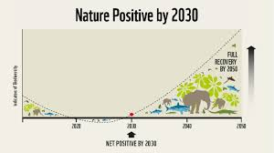

Impact of Findings
1.Policy Making:
The trends and relationships identified can help policymakers understand the progress and areas needing attention in sustainable energy adoption.
Countries with slower adoption rates can learn from those with successful strategies, fostering a global movement towards cleaner energy.
2. Investment Decisions:
Investors and stakeholders in the energy sector can use this data to identify promising markets for renewable energy investments.
The positive impact on CO2 emissions from low-carbon electricity suggests economic and environmental benefits from investing in such technologies.
3. Public Awareness:
These findings can be used to raise public awareness about the benefits of renewable energy and the importance of transitioning to low-carbon electricity sources.
Encouraging public and private sectors to support sustainable energy initiatives can accelerate the global shift towards cleaner energy.

Slide 26


Future Work
1. Detailed Country-Specific Studies:
Conducting more detailed studies on specific countries or regions to understand unique challenges and opportunities.
Investigating socio-economic factors influencing renewable energy adoption and access to electricity.
2. Impact Analysis:
Analyzing the direct and indirect impacts of increased renewable energy use on local economies, employment, and public health.
Studying the long-term environmental benefits of shifting to renewable energy and low-carbon electricity.
3. Technology and Innovation:
Exploring advancements in renewable energy technologies and their potential scalability.
Assessing the role of innovation in storage solutions, grid management, and energy efficiency in supporting the energy transition.

Slide 27
REFERENCES
DataSet Used : Global Data on Sustainable Energy
TOOLS & SOFTWARE Used :
Programming Languages: Python
Libraries: pandas & numpy for data manipulation matplotlib & seaborn for data visualization
IDE : Visual Studio Code
LINK TO THE GITHUB REPO

Slide 28
THANK YOU!

